Slide 1
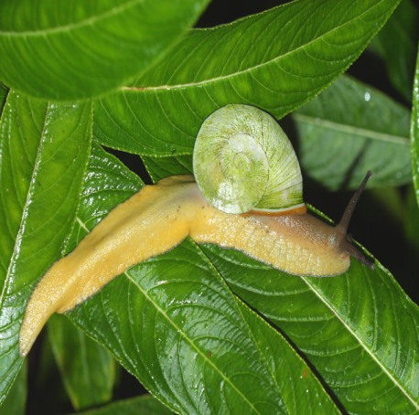
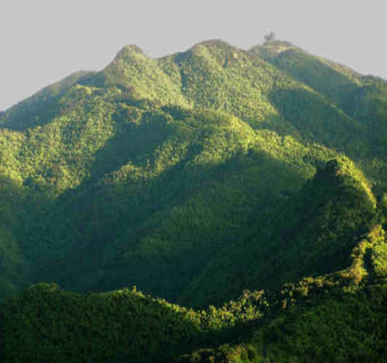
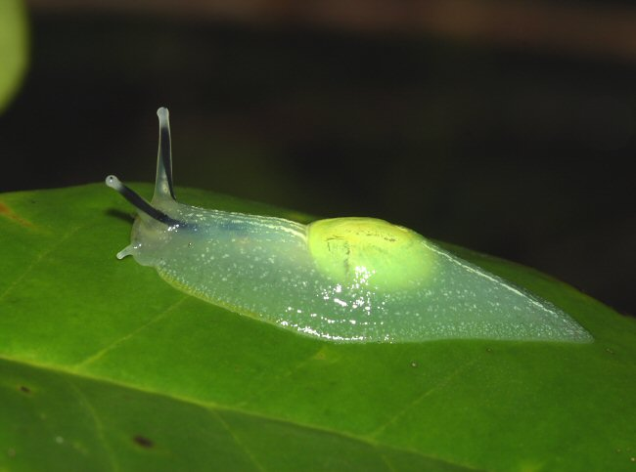
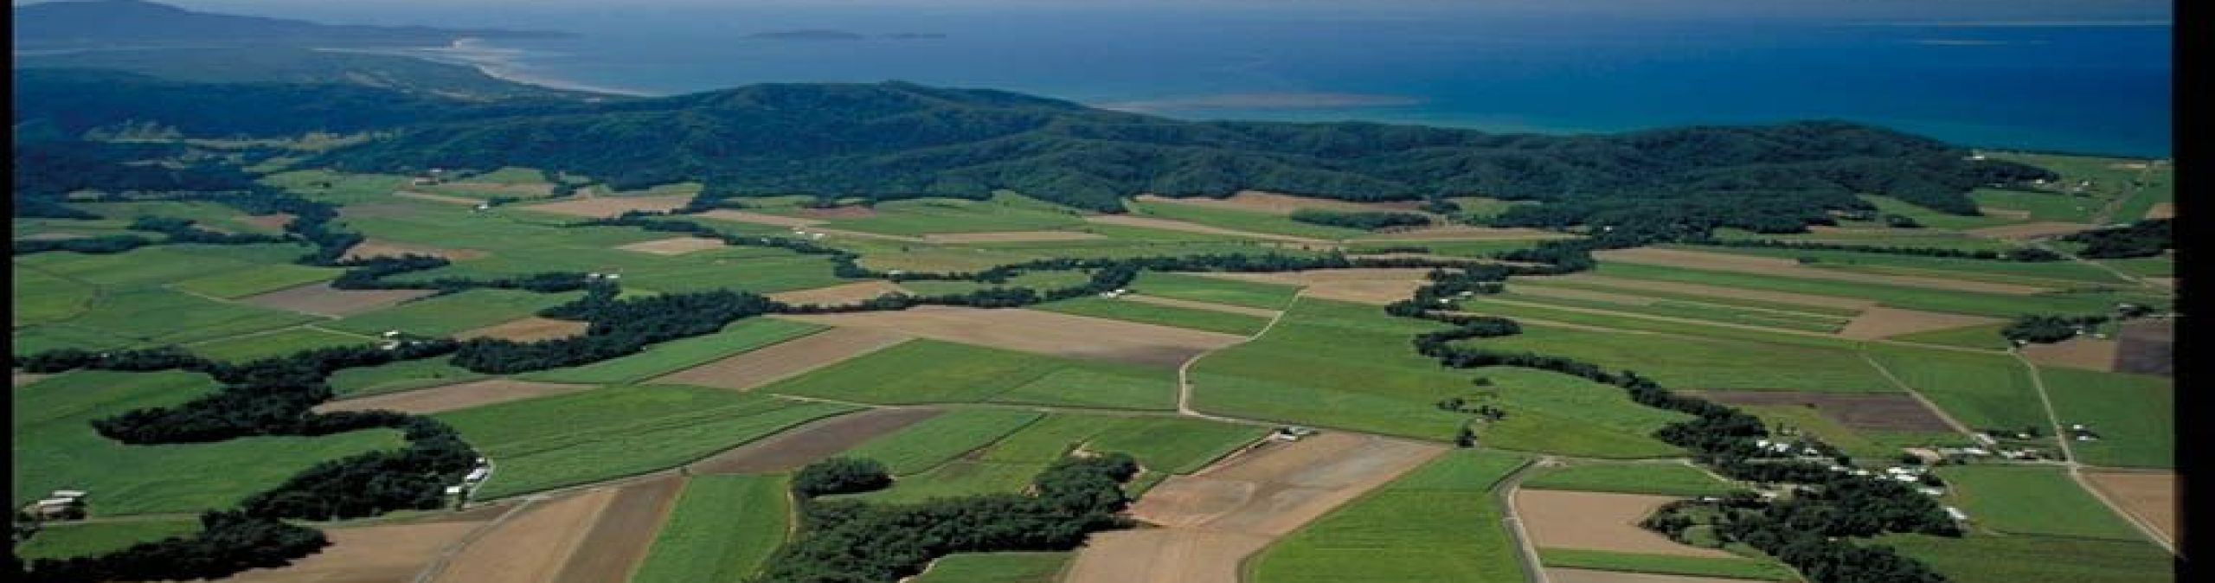
Field
Research in
Tropical
Puerto Rico:
Big Ideas with Small Species
o
Michael R. Willig & Steven J. Presley
Ecology & Evolutionary Biology
Center for Environmental Sciences & Engineering
Institute of the Environment
University of Connecticut
I E

Slide 2
Long-Term Ecological
Research in Puerto Rico
Spatial & Temporal Changes in
Gastropod Biodiversity
Global Change
Warming – Hurricanes – Droughts
o
I E
Institute of the Environment
Empowering Solutions for a Sustainable Future
Notes:
Our research focuses on long term spatiotemporal variation (variation in space and time) in abundance and diversity of gastropods in Puerto Rico in response to manmade (logging and coffee plantations) and natural disturbances (hurricanes and drought).

Slide 3
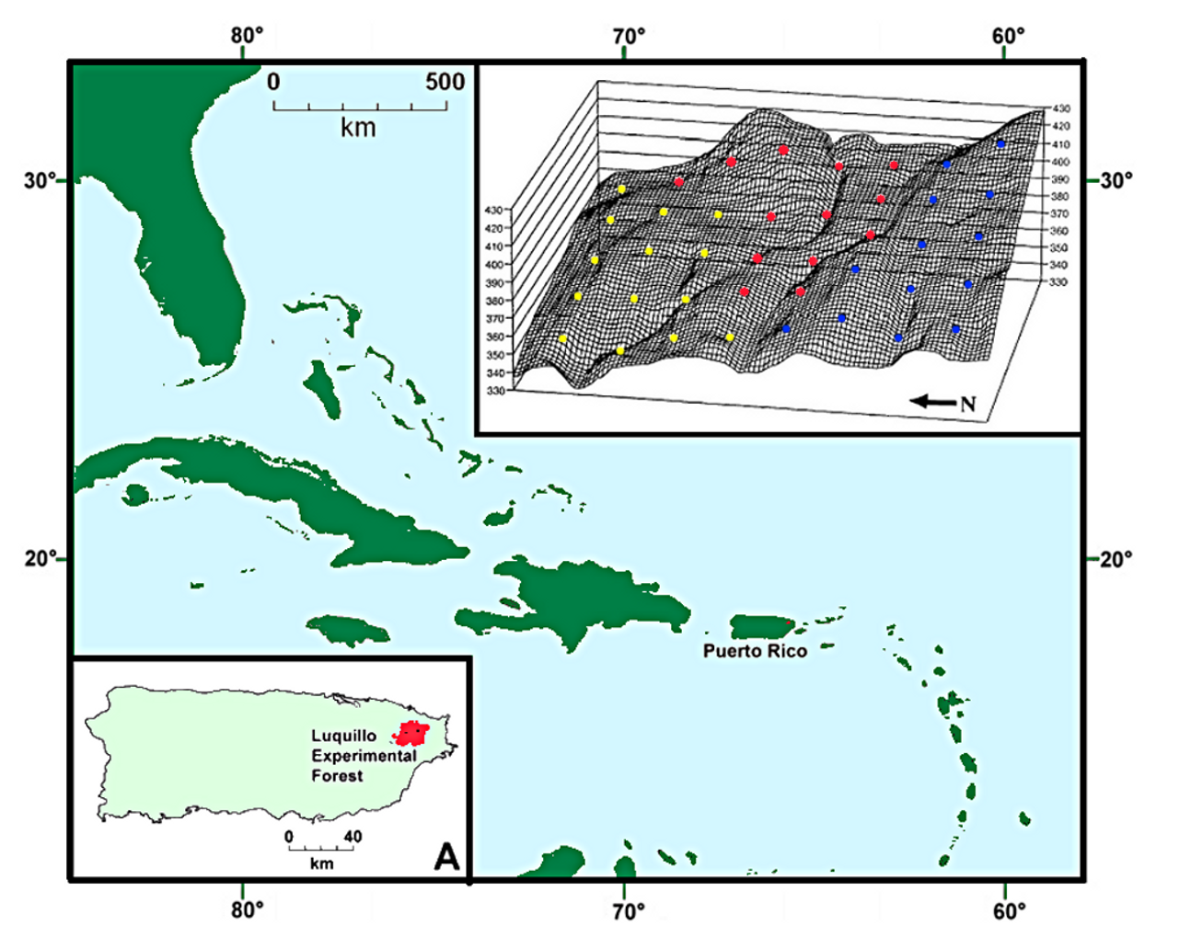
Biogeographic Context
Luquillo Mountains, Puerto Rico, Caribbean
o
I E
Institute of the Environment
Empowering Solutions for a Sustainable Future
Notes:
Puerto Rico is the smallest of the large islands in the Greater Antilles. Our work is in the Luquillo Experimental Forest (which is part of the Caribbean National Forest) in Northeastern Puerto Rico.

Slide 4
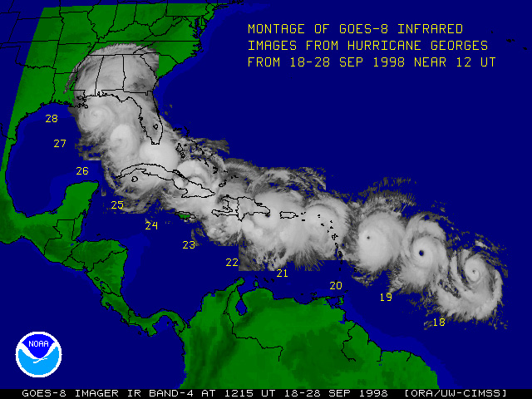
Hurricane-Mediated Systems
o
I E
Institute of the Environment
Empowering Solutions for a Sustainable Future
Notes:
Hurricanes are common in the Caribbean, resulting in ecosystems, flora, and fauna that are adapted to repeated large scale natural disturbances.

Slide 5
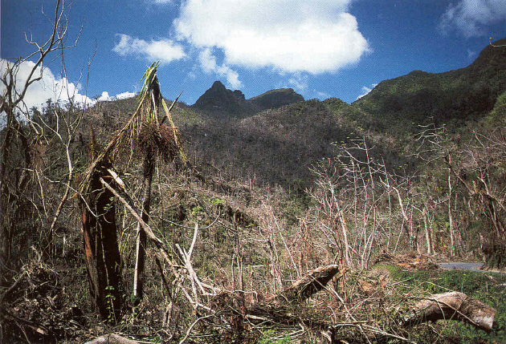
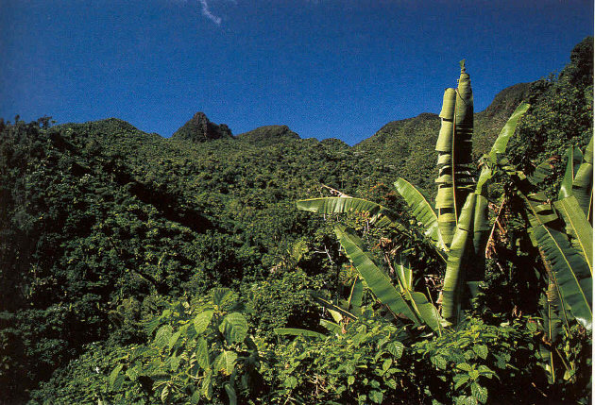
Hurricane Effects
Immediately After
Hurricane Hugo
5 Years
After
Hurricane Hugo
o
I E
Institute of the Environment
Empowering Solutions for a Sustainable Future
Notes:
Hurricanes can have devastating effects on the forest, defoliating most plants, breaking off branches, and knocking over large trees. However, the forest generally regenerates relatively quickly.

Slide 6
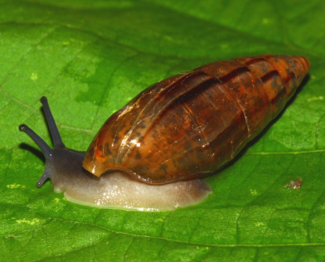

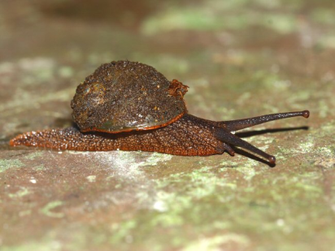
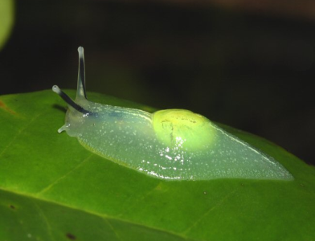
Gastropod Biodiversity
Locally Abundant
Species Rich
Functionally Important
Respond to Habitat Heterogeneity
Respond to Disturbance
o
I E
Institute of the Environment
Empowering Solutions for a Sustainable Future
Notes:
Gastropods are abundant in the forest, about 15 species are commonly found in the forest, they are functionally important as herbivores and in nutrient cycling, and respond to habitat heterogeneity at multiple spatial and temporal scales. The abundance and diversity of this group makes them a useful focal taxon for the study of spatiotemporal dynamics

Slide 7

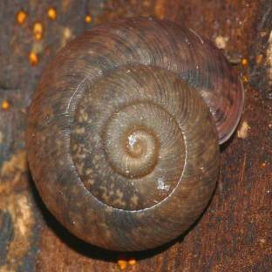
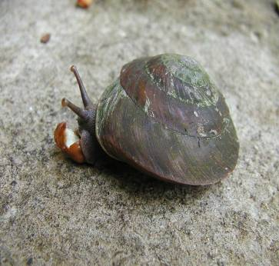
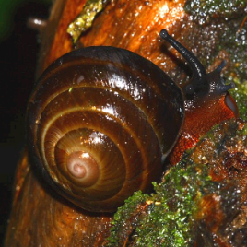
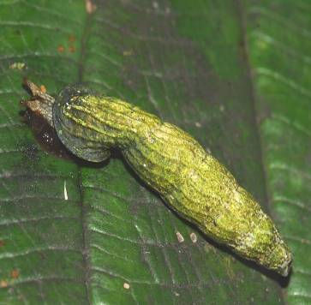
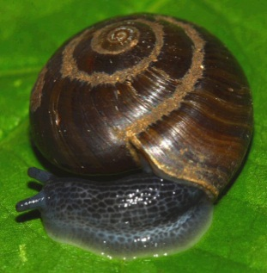

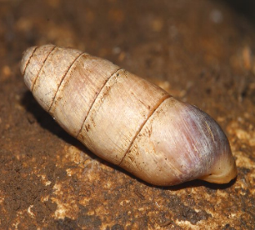

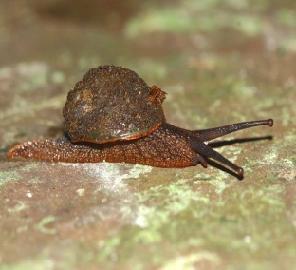
Gastropod Biodiversity
17 Species
Multiple Surveys for Each Project
20:00 to 04:00 Hours
Non-destructive Sampling
o
I E
Institute of the Environment
Empowering Solutions for a Sustainable Future
Notes:
In general, we leave for the field around sundown (7:30 pm or so) and begins sampling around 8:00 pm, with work lasting as late as 4:00 am. Sampling is non-intrusive and observational in nature. We check all visible surfaces, but we don’t go through the leaf litter or otherwise manipulate material in search of snails. At different points or plots, other groups may also be doing surveys of plants, soil nutrients, litter, litter invertebrates, frogs, lizards, or arboreal arthropods.

Slide 8
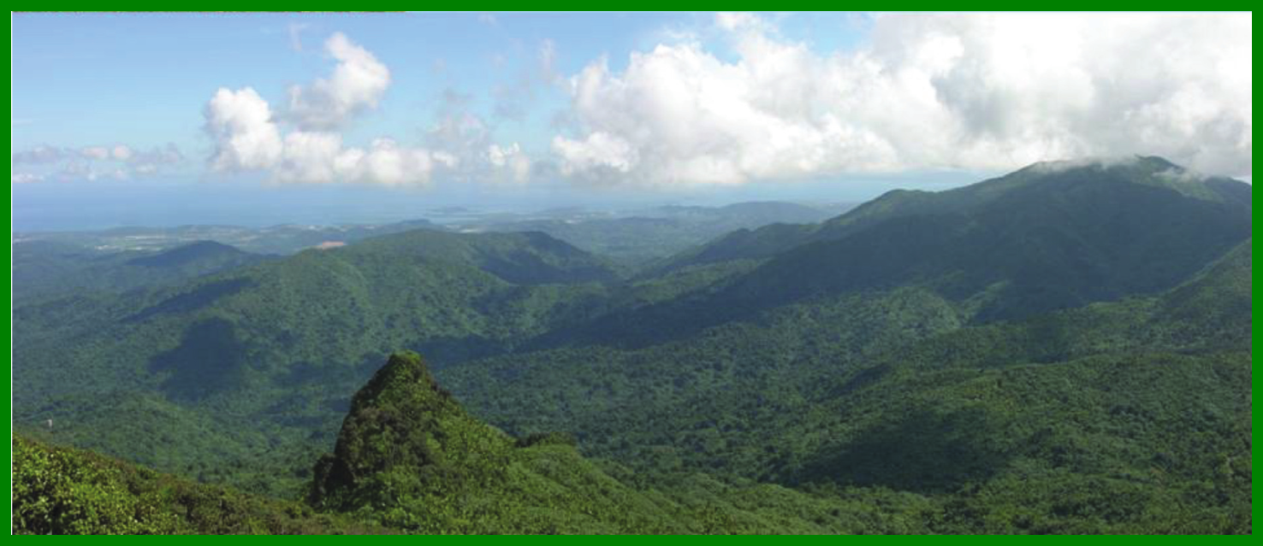
Three Projects in 2023
Luquillo Forest Dynamics Plot (LFDP)
Canopy Trimming Experiment (CTE)
Long-Term Elevational Plots (LTEP)
o
I E
Institute of the Environment
Empowering Solutions for a Sustainable Future
Notes:
There are 2 projects that we will work on this summer.
The Luquillo Forest Dynamics Plot is where we conduct long-term monitoring or responses to hurricanes, which started in 1991.
The Canopy Trimming experiment is an experimental manipulation is designed to simulate combinations of hurricane effects on the forest. This started in 2003.

Slide 9
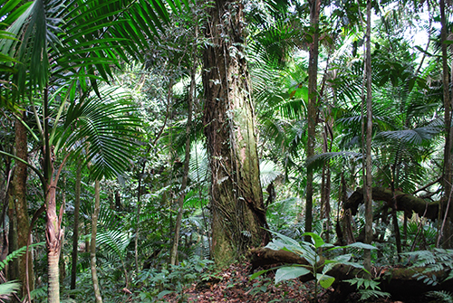
L F D P – Tabonuco Forest
Subtropical wet forest (~350 cm/year)
Dominant tree is Dacryodes excelsa (Tabonuco)
Somewhat seasonal (Wet, May-December; Dry, January to April)
Relatively “constant temperature”
o
I E
Institute of the Environment
Empowering Solutions for a Sustainable Future
Notes:
We survey 40 points 4 times each year to monitor long-term responses of gastropods and walking sticks. This grid was set up after Hurricane Hugo (1989), but was also hit by Hurricane Georges in 1998.

Slide 10
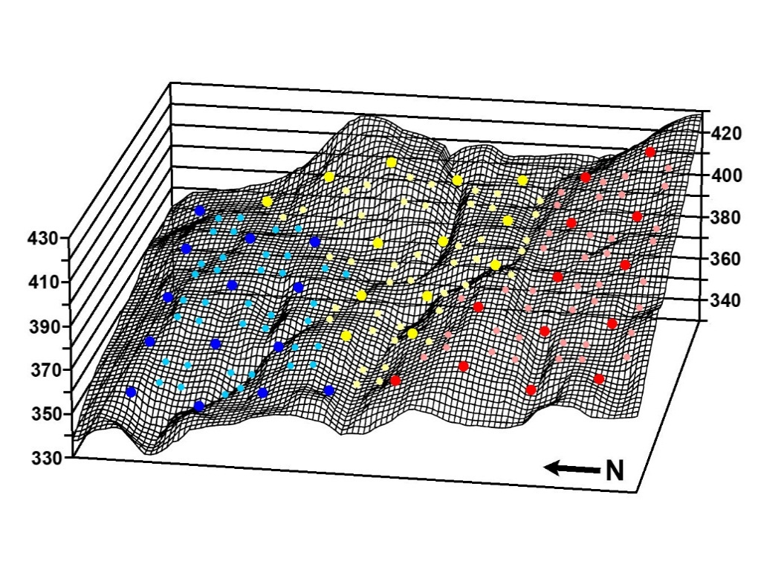
L F D P
Blue — Shade coffee and small-scale agriculture
Yellow — intensive logging and agriculture
Red — Light selective logging
16 ha grid dedicated to long-term study of biota and processes
Circular plots (3 m radius)
60 m inter-plot spacing of 40 points (large circles)
Three major hurricanes: Hugo [1989], Georges [1998], Maria [2017]
o
I E
Institute of the Environment
Empowering Solutions for a Sustainable Future

Slide 11
Predictions for Density in 2023
Gastropods
Long-Term Trend vs Hurricane-Specific Response
Increase?
Decrease?
o
I E
Institute of the Environment
Empowering Solutions for a Sustainable Future

Slide 12
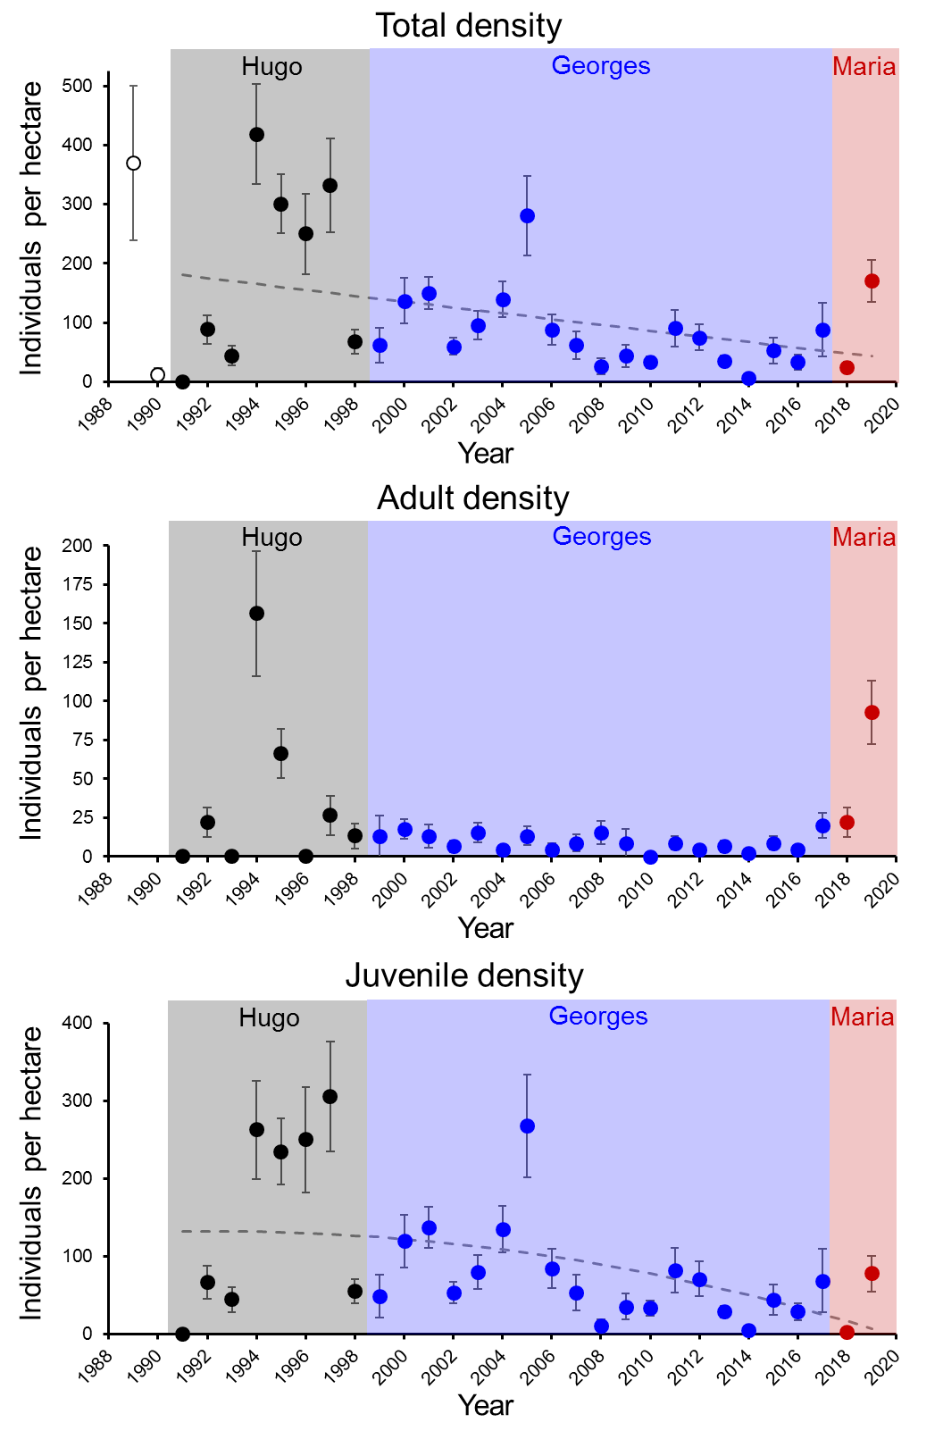
Predictions for Density in 2023
Walking Sticks
Long-Term Trend vs Hurricane-Specific Response
Increase?
Decrease?
o
I E
Institute of the Environment
Empowering Solutions for a Sustainable Future

Slide 13
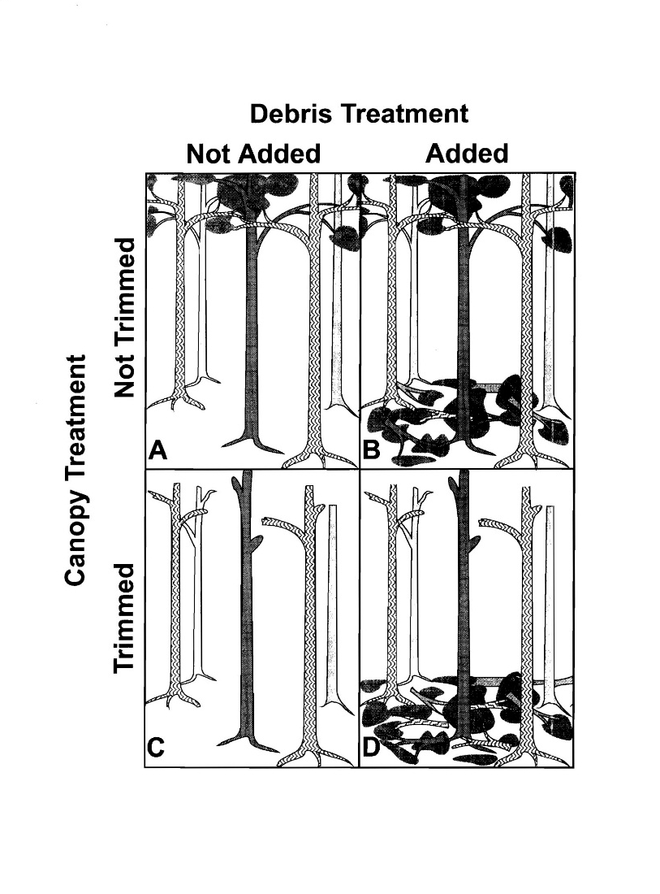
Canopy Trimming Experiment (CTE)
Phase I
Tabonuco Forest
o
I E
Institute of the Environment
Empowering Solutions for a Sustainable Future
Notes:
Hurricanes defoliate the canopy and deposit that vegetation on the forest floor. This experiment was designed to disentangle the effects of canopy loss from the deposition of the lost vegetation on the forest floor. This experiment started in 2003.

Slide 14
C T E
Phase II
Tabonuco Forest
o
I E
Institute of the Environment
Empowering Solutions for a Sustainable Future
Notes:
Phase II of the experiment was executed about 6 years ago, but only “treatment D“ was repeated in order to simulate re-occurring hurricanes, the control (treatment A) requires no modification, and treatments B and C from phase I were unaltered to continue to monitor long-term responses.

Slide 15
C T E
Forest floor
Forest canopy
Time
0
1 year
later
o
I E
Institute of the Environment
Empowering Solutions for a Sustainable Future

Slide 16

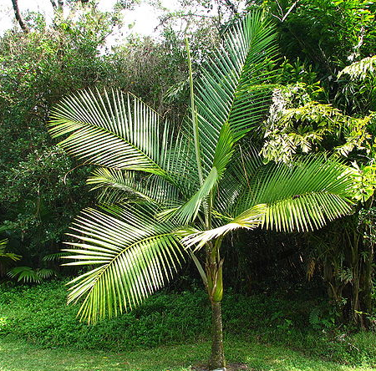
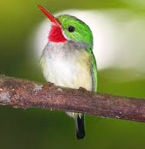
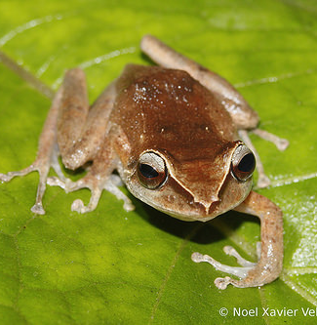
Long-Term Elevational Plots (LTEP)
Synoptic Network for Change
Climate Change
and
Land Use Change
o
I E
Institute of the Environment
Empowering Solutions for a Sustainable Future
Notes:
Phase II of the experiment was executed about 6 years ago, but only “treatment D“ was repeated in order to simulate re-occurring hurricanes, the control (treatment A) requires no modification, and treatments B and C from phase I were unaltered to continue to monitor long-term responses.

Slide 17
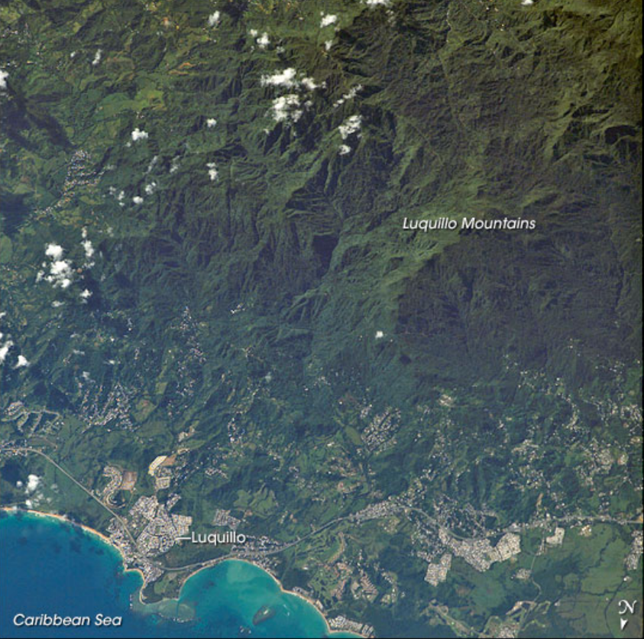

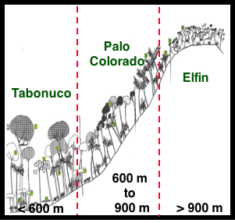
L T E P
o
I E
Institute of the Environment
Empowering Solutions for a Sustainable Future

Slide 18
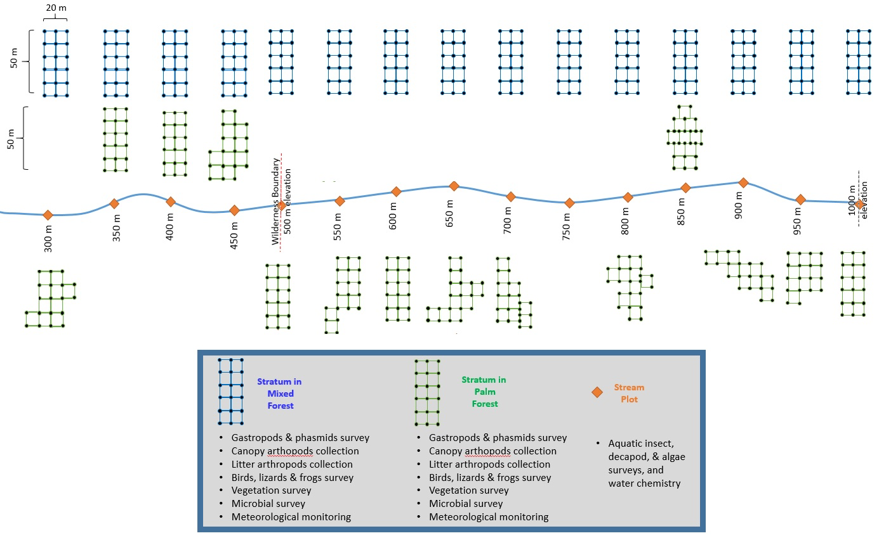
L T E P
o
I E
Institute of the Environment
Empowering Solutions for a Sustainable Future

Slide 19
L T E P
o
I E
Institute of the Environment
Empowering Solutions for a Sustainable Future

Slide 20
L T E P
Gastropod Populations & Communities
o
I E
Institute of the Environment
Empowering Solutions for a Sustainable Future

Slide 21
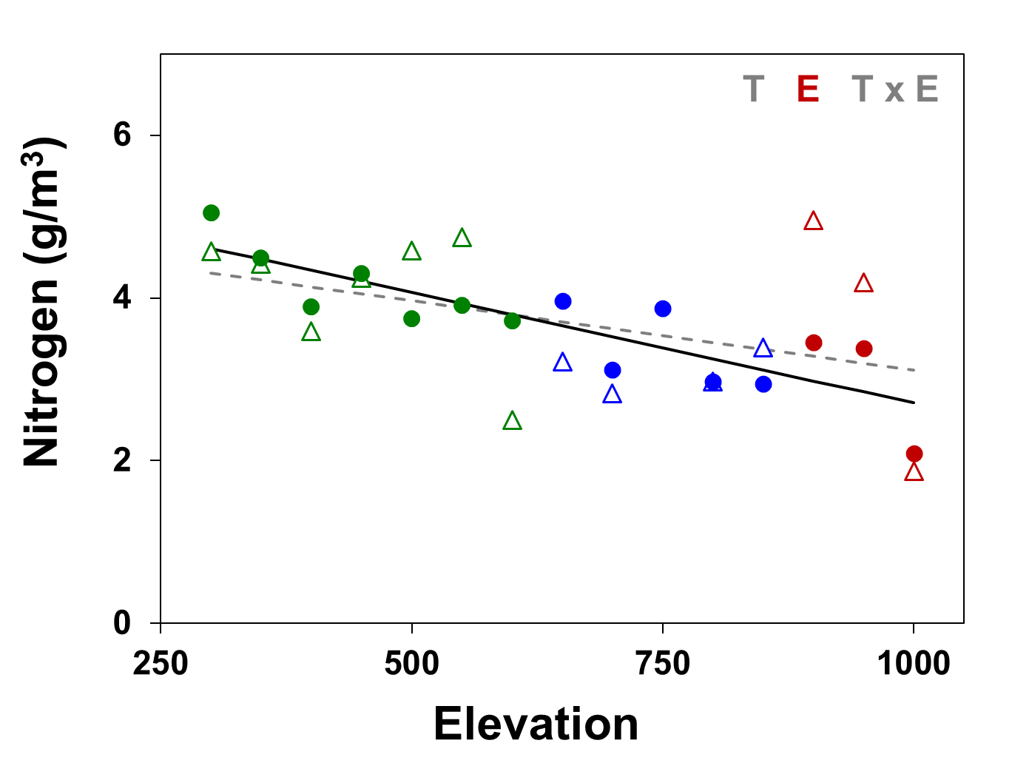
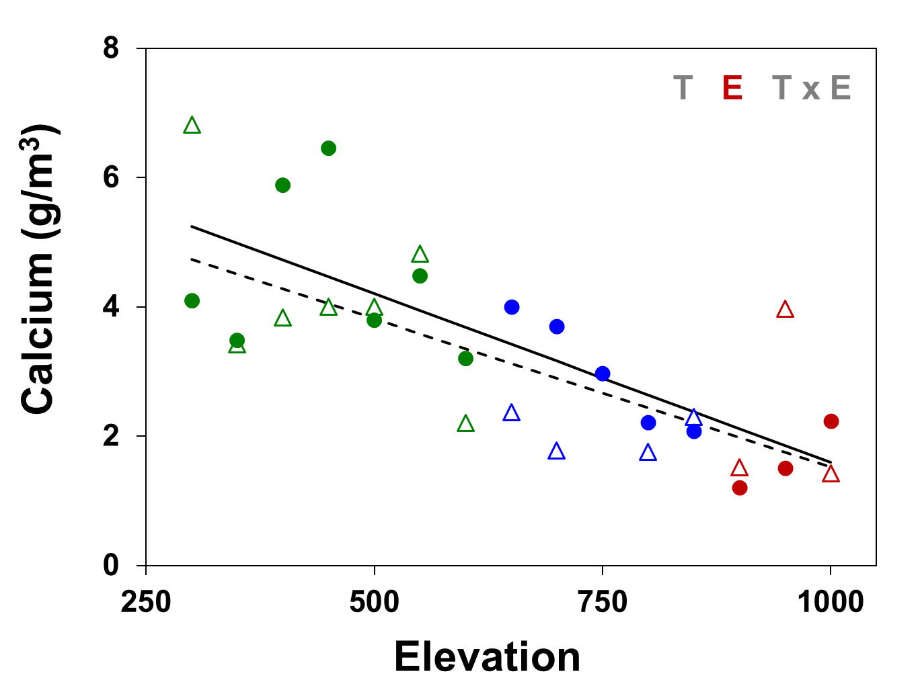
L T E P
Nutrients
Nitrogen
Calcium
o
I E
Institute of the Environment
Empowering Solutions for a Sustainable Future

Slide 22
L T E P
Metacommunities
E M S
Metacommunities
Mixed Forest vs Palm Forest
o
I E
Institute of the Environment
Empowering Solutions for a Sustainable Future

Slide 23
Additional Notes
Round-trip airfare will be provided (BDL-SJU)
Lodging will be provided (EVFS)
Modest stipends are available for those with financial need
No credit if only committed to field work
Credit in summer or fall if research is of interest (Further Discussion Required)
o
I E
Institute of the Environment
Empowering Solutions for a Sustainable Future
Notes:
First, please confirm that you remain interested in working on the project.
If you have not already done so, please provide a brief resume and contact information for two references. We also need to know your availability to travel to Puerto Rico during June, July, and August this year. Also provide any information on allergies (food, insect bites) or health or physical issues that you have that we need to be aware of to ensure your safety in the field. Also let us know if you are interested in doing independent study or working as a lab assistant. Ask any questions you may still have.

Slide 24
Next Step – Email:
Confirm Interest in position
Send brief Resume (1-2 pages)
Include 2-3 References (Professor, TA, Employer)
Availability to travel to Puerto Rico during June, July, and August 2023
Health, Allergy, or Disability Issues so that we can enhance your safety
Questions or Concerns?
o
I E
Institute of the Environment
Empowering Solutions for a Sustainable Future
Notes:
First, please confirm that you remain interested in working on the project.
If you have not already done so, please provide a brief resume and contact information for two references. We also need to know your availability to travel to Puerto Rico during June, July, and August this year. Also provide any information on allergies (food, insect bites) or health or physical issues that you have that we need to be aware of to enhance your safety in the field. Also let us know if you are interested in doing independent study or working as a lab assistant. Ask any questions you may still have.

