Slide 1
NGS: Next-Generation [high throughput] Sequencing I: Background
Nearly all modern DNA sequencing procedures require a concentrated amount of
single-stranded DNA known as a template. A template is simply a piece of DNA of
sufficient length and quality to allow for its sequencing (most sequencing methods
require a large pool of identical molecules in order to adequately detect sequencing
products (exceptions: e.g., Helicos NGS). Templates are generated by the following methods:
1) cloning: cut up genomic DNA in random pieces; insert each piece into a bacterial vector
to generate millions of copies of the original piece.
2) in vitro amplification methods (PCR): target specific DNA region using oligo
primers (must know something about sequence of target at 5’ and 3’ ends to design
primers). A thermostable polymerase and dNTPs are used to synthesize DNA by
cycling through optimal melting, annealing and extension temperatures.
There is an inherent ERROR RATE associated with various forms of TAQ polymerase,
which originally lacked 3' to 5' exonuclease proofreading activity. Newer bioengineered
forms have proofreading to reduce error rates. However, no TAQ is error free.

Slide 2
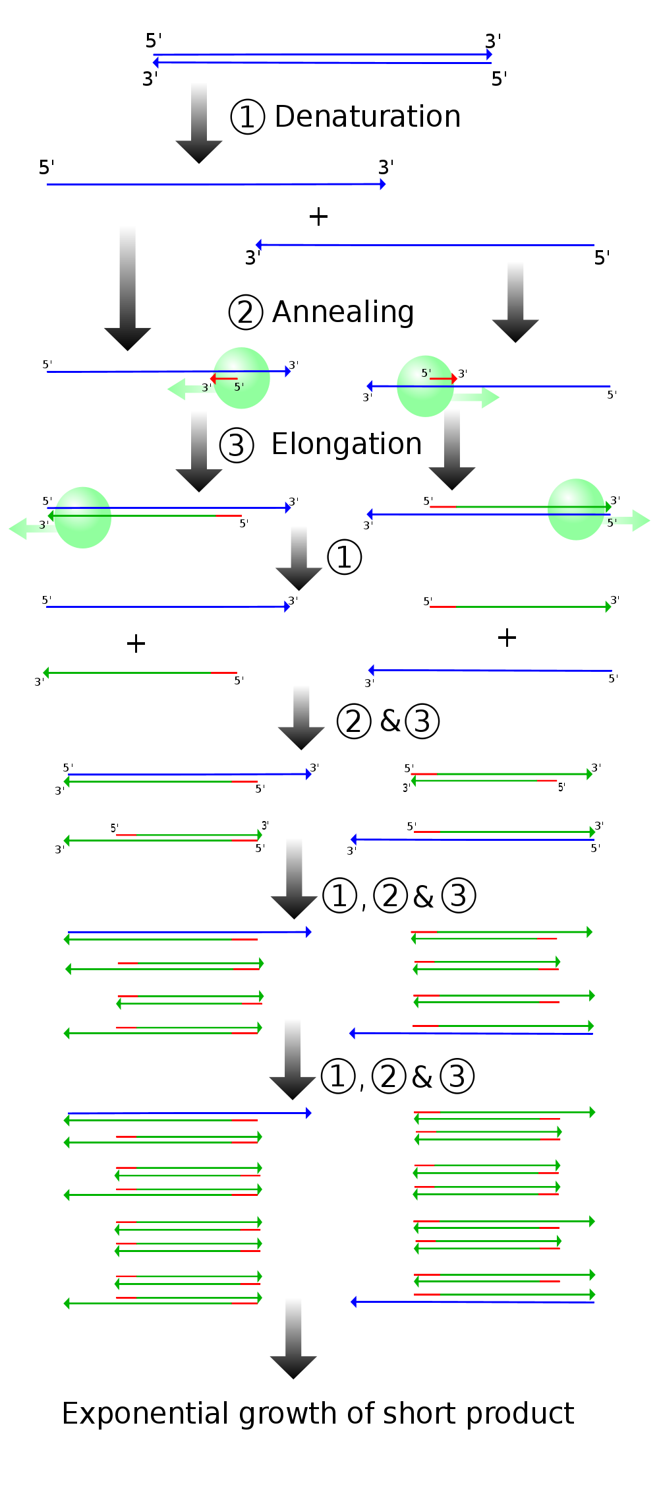
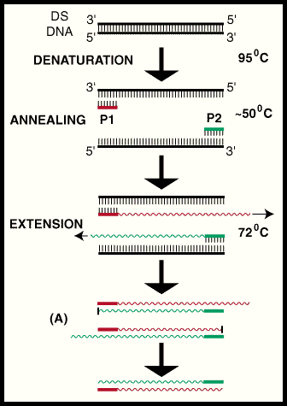
Basic PCR

Slide 3
3) subcloning: ligate already amplified PCR products into bacterial vector to obtain single
molecule sequence (only ssDNA is incorporated). Useful for heterozygotes, hybrids, etc.;
however, error rate (see above) can complicate analyses
Sanger sequencing (1st generation; cited over 57,000 times): provides short reads
(~700-900 bp) for single regions via synthesis from a template (NGS contrasts by producing
millions of sequences simultaneously):
“oligo” primer
TGCACATG →
ACGTGTACAGTACAGATTTAGCGTGATAGGCAGATCCACGATAGGCATGACGAC
DNA polymerase + dNTPs + ddNTPs (chain terminators – incorporate randomly;
each labeled with a different fluorescent dye)
TGCACATGTCATGTCTAAATCGCACTATCC*
ACGTGTACAGTACAGATTTAGCGTGATAGGCAGATCCACGATAGGCATGACGAC
TGCACATGTCATGTCTAAATCGCACTATC*
ACGTGTACAGTACAGATTTAGCGTGATAGGCAGATCCACGATAGGCATGACGAC
TGCACATGTCATGTCTAAATCGCACTATCCGT*
ACGTGTACAGTACAGATTTAGCGTGATAGGCAGATCCACGATAGGCATGACGAC

Slide 4
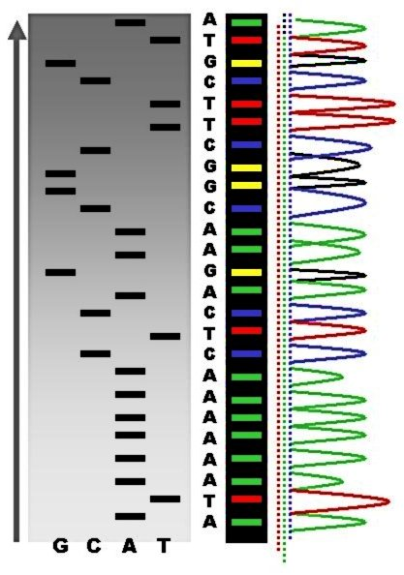
Labeled fragments are sorted by size as they move through a gel. Originally, sequences were read manually off of large polyacrylamide gels (PAGE), which effectively sorted radiolabeled fragments:
Autoradiogram of a PAGE sequencing run (left) compared to automated sequencer (right)

Slide 5
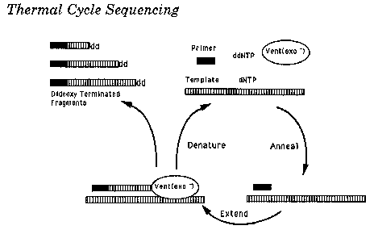
In modern “ABI” type systems, the gel is contained within a fine capillary, where the fluorescent tags of each fragment are read
by a laser as they pass the detector. This technique extends the read length and quality by avoiding the “bunching” of bands at
the top of a PAGE gel.
Cycle sequencing: Most common application of modern Sanger type sequencing; uses protocol similar to PCR (but with only
one primer) to denature, amplify and sequence simultaneously. Successive rounds of denaturation, annealing, and extension
are run in a thermal cycler, which results in linear (not exponential) amplification of extension products; uses TAQ, so error rates
apply here as well.

Slide 6
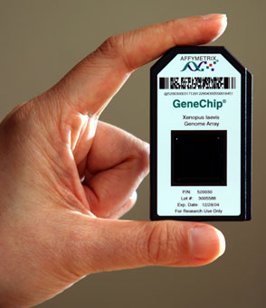
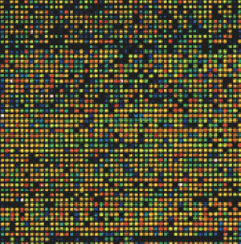
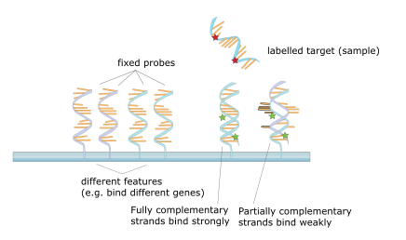
Microarrays (DNA/gene chips) [developed in late 1990’s]:
gene chips
NGS platforms typically incorporate some form of microarray consisting of oligo probes (mostly) or longer template DNA
molecules. A microarray is a solid surface (glass, silicon, polystyrene) to which short pieces of DNA having a specific (known)
sequence (called oligos, probes, or reporters) have been attached. The targets are labeled in some way (e.g., fluorescence)
to enable their detection when present.
Microarrays are used to measure expression levels (via cDNA) for large numbers of genes simultaneously, for SNP [“snip”]
detection (single-nucleotide polymorphisms), or to genotype multiple genomic regions. Microarrays are based on principles of
DNA-DNA hybridization. Highly complementary sequences remain attached to the microarray and the more weakly bonded pieces are washed off.

Slide 7
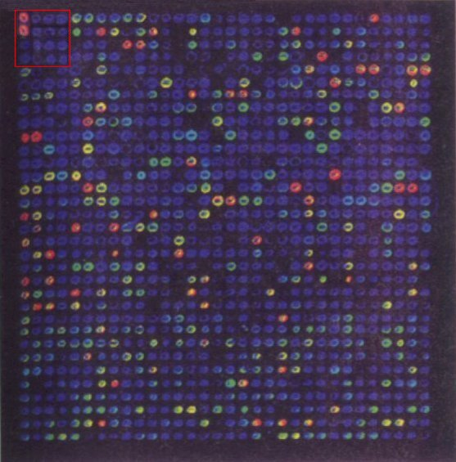
Microarrays: Popular applications: gene expression profiling, DNA copy number (comparative genomic
hybridization), SNPs, microRNAs, splicing (exon arrays)
Disadvantages:
• One must know the sequences to design the array
• Even if one knows the sequences, one cannot fit all of them in a small number of arrays
• High noise level due to cross-hybridization, non-linearity, etc.
Differential gene (RNA) expression compared among 1,046 different cDNA probes generated from a specific mRNA transcriptome. Relative expression levels are indicated by strong (red), moderate (yellow), weak (green) and poor (blue) “pseudocolors”, which are derived from binding levels.
- cDNA: complimentary DNA. DNA that can serve as a proxy for RNA (for gene expression studies) as it is synthesized
from an mRNA template using the enzymes reverse transcriptase and DNA polymerase. Because it is based on the mRNA
transcript, this procedure yields a DNA sequence that is devoid of introns.

Slide 8
Most NGS techniques are the resulting “hybrid” of DNA-DNA hybridization, PCR, Sanger sequencing, cycle sequencing and microarray developments. They essentially enable randomly sheared pieces of genomic DNA to become attached to an array, then amplified by PCR (in most cases), and then sequenced.
NGS methods exploit ability to bind random DNA fragments to an array by using adaptors.
DNA ligation: the method of joining DNA strands together by means of covalent phosphodiester bond formation. Uses DNA ligase and ATP.
DNA ligase will work with DNA strands with “blunt ends”, but is less efficient than joining “sticky ends”:
5'-TCTGACTGATGCGTATGCT-3' 5'-TCTGACT + GATGCGTATGCT-3‘
3'-AGACTGACTACGCATACGA-5 3'-AGACTGACTACG CATACGA-5'
“blunt” ends “sticky” ends
DNA ligation is used to attach the primer sites, adapters, bar-code sites, etc. to pieces of DNA. Most NGS use a type of blunt end ligation because no complimentary sequence is required, making it possible to attach the exact same adapter to random pieces of DNA.
Fragments with “sticky” ends, or any type of overhang can be “end polished” using T4 DNA polymerase, which fills the protruding 5’ end of the strand, making it blunt-ended.

Slide 9
shotgun sequencing (shotgun cloning): the basis of NGS methodologies where short sequencing protocols are used to
sequence multiple randomly fragmented DNAs, so that a longer piece can be reconstructed using regions of overlap. e.g.:
small randomly sequenced pieces:
short, randomly sequenced DNAs pieces are evaluated for overlapping areas
AAAGCATGATGGTCCGAT AAAGCATGATGGTCCGAT
GTCCGATTACGTCAT GTCCGATTACGTCAT
GTCATCGTGTACCC GTCATCGTGTACCC
“contig”: AAAGCATGATGGTCCGATTACGTCATCGTGTACCC
(analogous to parallel processing (millions of sequences throughout genome)
This process is repeated millions of times throughout the genome.

Slide 10
NGS: Next-Generation Sequencing II: Template Preparation (generate clusters of identical DNA molecules for adequate detection)
Emulsion PCR (emPCR)
In emulsion PCR, a DNA library is first generated through random fragmentation of genomic DNA (300-800 bp). The fragment ends are polished (to provide blunt ends) and short adaptors are ligated onto them. Unique ID adaptors also can be added to multiplex as many as 96 different source templates simultaneously.
The adaptors provide priming sequences for both amplification and sequencing. One adaptor (B) contains a 5'-biotin tag enabling the immobilization of the DNA library onto streptavidin-coated beads (biotin and streptavidin exhibit an intense, non-covalent binding). After nick repair, the non-biotinylated strand is released and used as a single-stranded template DNA (sstDNA) library.
Single-stranded DNA templates are attached to the surface of beads by the adaptors, which are complementary to oligonucleotide probes present on the surface. Each bead is attached to a single DNA fragment from the DNA library.
The beads (with their bound DNA template) are then compartmentalized into water-oil emulsion droplets, which also contain the PCR reaction mixture. In the aqueous water-oil emulsion, each of the droplets capturing one bead functions as a PCR microreactor that produces several thousand amplified copies only of the single DNA template.
EmPCR has the advantage of avoiding the arbitrary loss of genomic sequences inherent in bacterial cloning methods. A library of fragment or mate-pair targets is created, and adaptors containing universal priming sites are ligated to the target ends, allowing complex genomes to be amplified with common PCR primers. After ligation, the DNA is separated into single strands and captured onto beads under conditions that favor one DNA molecule per bead
*emPCR is used in 454, SOLiD, and Ion Torrent sequencing platforms

Slide 11
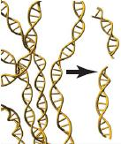
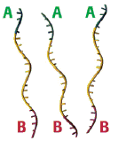
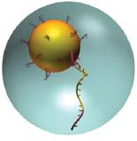
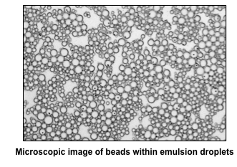
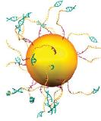
emPCR (as used in 454 sequencing)
fragment genomic DNA ligate adaptors onto fragments attach 1 DNA strand to each bead
in an emulsion droplet
perform PCR in each droplet;
remove (break) emulsion shell

Slide 12
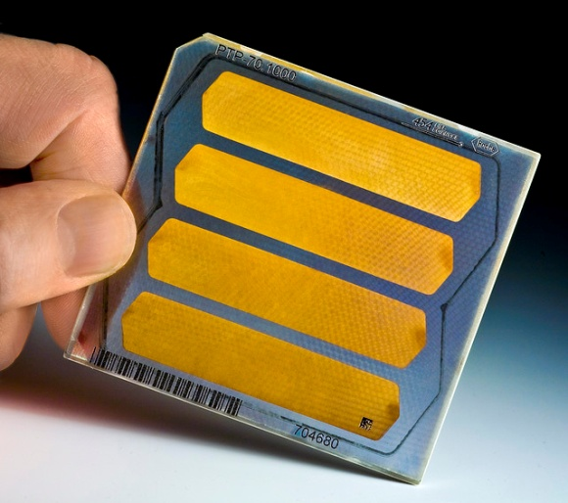

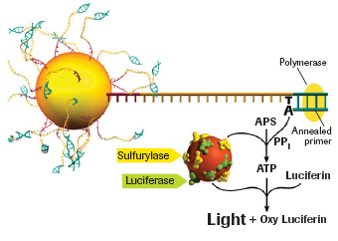
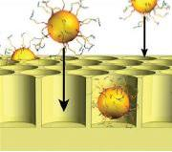
PicoTiter plate
SEM of wells
sequence by sequentially washing plates with
A, C, G, T; light is released if a base is incorporated;
a camera is used to detect the light flash
load beads into PicoTiter Plate;
add reagent beads to wells

Slide 13
B. Solid-phase (i.e., non-emulsion) PCR: Bridge Amplification (used in Illumina systems only).
Don’t confuse “solid phase” with SOLiD!
In this method, the amplification reaction occurs on the surface of the flow cell, which is coated with single stranded oligonucleotides corresponding to the sequences of the adapters ligated during the sample preparation stage.
Single-stranded, adapter-ligated fragments are bound to the surface of the flow cell and then exposed to reagents for polyermase-based extension.
Priming occurs as the free/distal end of a ligated fragment "bridges" to a complementary oligo on the surface.
Repeated denaturation and extension results in localized amplification of single molecules in millions of unique locations across the flow cell surface, which are referred to as "clusters".

Slide 14
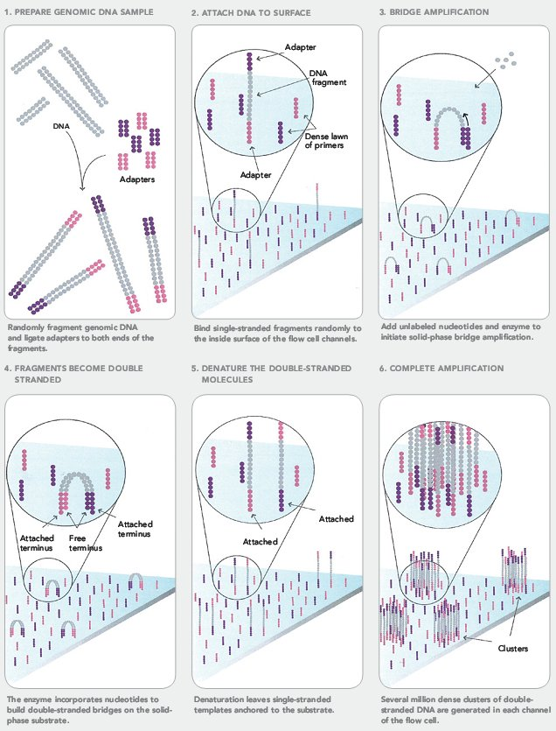
Bridge amplification
(Illumina systems)

Slide 15
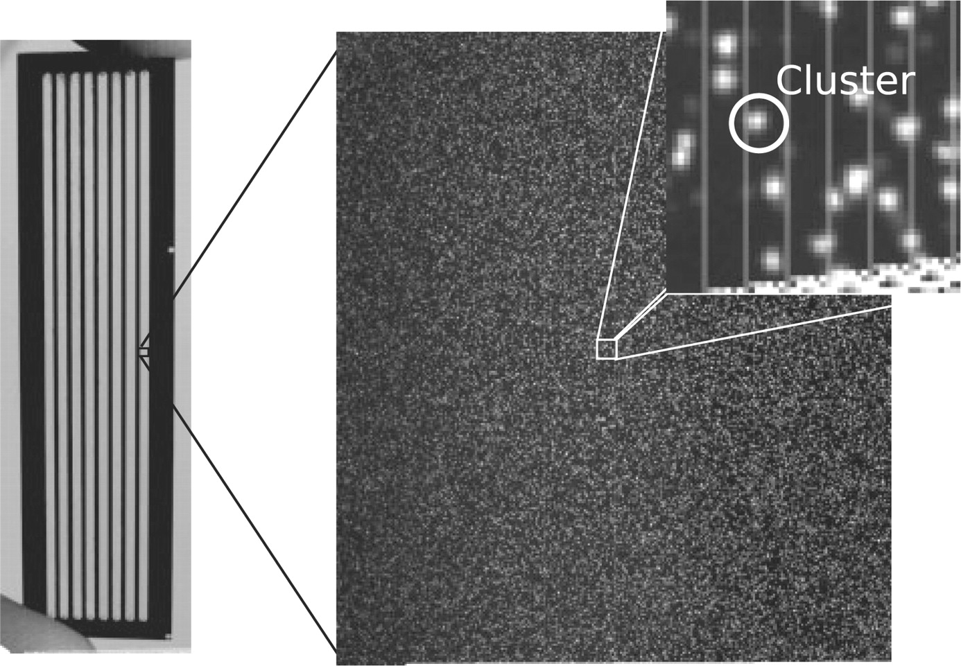
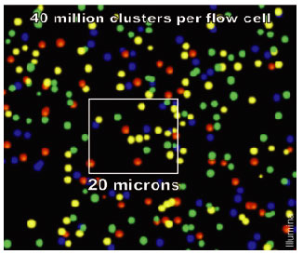
Illumina 8-cell flow cell showing cluster formation

Slide 16
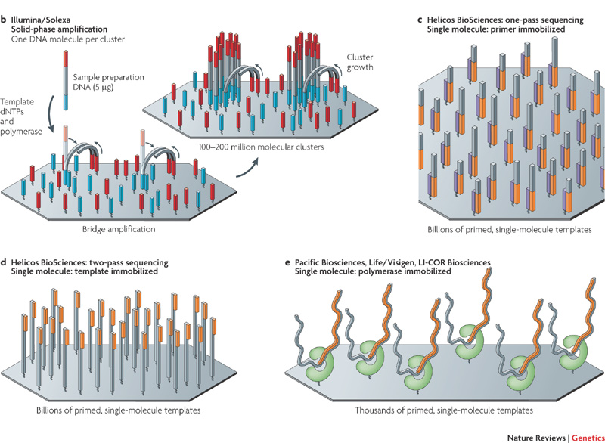
C. Single-molecule systems (Helicos, Pacific BioSciences/Li-Cor) [“3rd-generation´systems”]
These methods require no PCR or other type of template amplification, because the sequences are obtained directly from single DNA molecules. Because this approach avoids PCR, it should have the lowest error-rate of any NGS methodology; however, initial versions of the technology are sequencing at less than 85% accuracy and require combined 454 or Illumina runs to correct reads! Not quite yet ready for prime time, but becoming more prevalent.
3 ways to immobilize templates to a solid support for single-molecule sequencing:
Helicos: single-molecule (no PCR): primer immobilized [one-pass]
Helicos: single-molecule (no PCR): template immobilized [two-pass]
Pacific BioSciences/Li-Cor: single-molecule (no PCR): polymerase
immobilized

Slide 17
NGS: Next-Generation Sequencing III: Template immobilization types
Michael L. Metzker: Nature Reviews Genetics 11: 31-46 (2010).
“Sequencing by synthesis” (SBS) platforms:
a. 454 (pyrosequencing): sequence-by-synthesis method that detects the pyrophosphate released as a nucleotide is incorporated by using a chemiluminescent enzyme (luciferase) and a light detector. 454 was the first NGS on the market (2005).
1). perform emPCR
2). sequence complimentary strand by DNA synthesis
3). detect light emitted by chemiluminescent reaction involving released pyrophosphate as each nt is incorporated
Homopolymer repeats (e.g. GGGGG) in the template result in consecutive multiple light bursts, which can “saturate” photodetector, causing erroneous count of nts in the repeat (see also Ion Torrent).
b. Ion Torrent (http://www.youtube.com/iontorrent): Similar to 454 but measures pH change (instead of light) as nucleotides are incorporated (incrementally flood plate with each nt until a signal is obtained for one).
1). perform emPCR
2). sequence complimentary strand by DNA synthesis
3). detect pH change as each nt is incorporated
- If homopolymer repeats (e.g. GGGGG) are present on the template (strand to be sequenced) then multiple introduced nucleotides are incorporated and more hydrogen ions are released in a single cycle. This results in a greater pH change and a proportionally greater electronic signal. This limitation makes it difficult to enumerate long repeats.
c. Illumina (originally Solexa – 2nd system after 454): solid-phase amplification (polymerase-based sequence-by-synthesis)
Two basic steps: initial priming and extending of the single-stranded, single-molecule template, and bridge amplification of the immobilized template with immediately adjacent primers to form clusters.
For sequencing, only dye-labeled terminators are added; then the sequence at that position is determined for all clusters; next, the dye is cleaved and another round of dye-labelled terminators is added.
Multplexing: use of index tags can allow up to 12 samples per lane or 96 samples per flow cell. However, multiplexed samples divide up reads in each cell.
MiSeq: New version of Illumina system

Slide 18
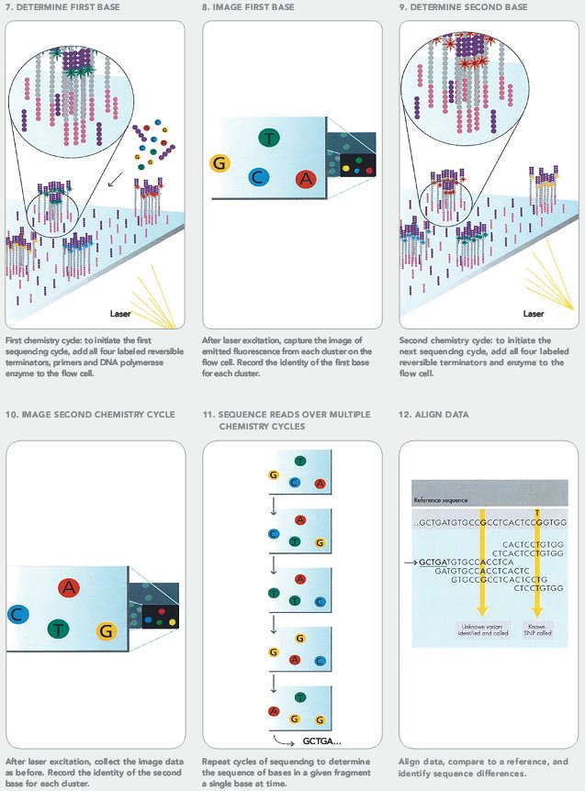
Illumina sequencing

Slide 19
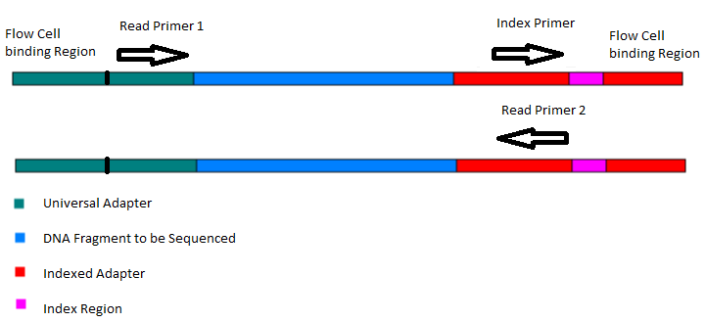
What is the difference between “Single-End” and “Paired-End” reads?
Single-End Read: When the sequencing process only occurs in 1 direction (utilizing Read Primer 1).
Paired-End Read: If two separate read cycles occur in both directions (utilizing both Read Primer 1 and 2). This kind of read will provide data about both sides of the fragment of interest (Blue). If the fragment size is consistent you will also be able to predict that both the forward and reverse reads will be a known distance from each other. These data can assist the software to map the reads more accurately.

Slide 20
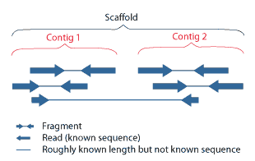
overlapping reads from paired-end sequencing form contigs; contigs and gaps of known length form scaffolds
In paired-end sequencing, both ends of consistently sized, longer DNA fragments are sequenced. Any contiguous stretch of sequence data created by read overlap still is referred to as a contig. Because the fragments are of known length, the distance between the two end reads from each fragment is known. This approach provides additional information about the orientation of contigs constructed from the reads and facilitates their assembly into scaffolds.
Scaffolds consist of overlapping contigs separated by gaps of known length. The additional constraints placed on contig orientation allow for the placement of highly repeated sequences in the genome. If one end read has a repetitive sequence, its placement can be determined as long as its mate pair is located within a contig. Any gaps remaining between scaffold contigs can be sequenced by “traditional” methods.

Slide 21
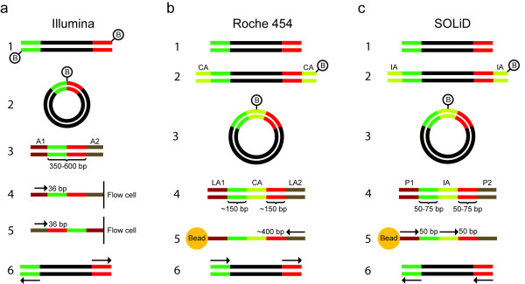
Principles for construction of mate-pair sequencing libraries
Illumina mate-pair libraries: Fragments are end-repaired using biotinylated nucleotides (1). After circularization, the two fragment ends (green and red) become located adjacent to each other (2). The circularized DNA is fragmented, and biotinylated fragments are purified by affinity capture. Sequencing adapters (A1 and A2) are ligated to the ends of the captured fragments (3), and the fragments are hybridized to a flow cell, in which they are bridge amplified. The first sequence read is obtained with adapter A2 bound to the flow cell (4). The complementary strand is synthesized and linearized with adapter A1 bound to the flow cell, and the second sequence read is obtained (5). The two sequence reads (arrows) will be directed outwards from the original fragment (6).
Roche 454 paired-end libraries (these are called paired-end, but are based on the same principles as the mate-pair libraries in the other technologies): Original fragments (1) are end-repaired with unlabeled nucleotides, and biotin-labeled circularization adapters (CA) are ligated to the fragment ends (2). After circularization (3), fragmentation and affinity purification, library adaptors (LA1 and LA2) are ligated to the new fragment ends (4) and the fragments are amplified on beads by emulsion PCR. One single sequence read that covers the two original ends and the internal adapter is generated (5). Adapter sequence is removed in silico, and the sequence is split into two reads, which both have the same orientation (6).
SOLiD mate-pair libraries: Steps 1 to 4 are analogous with preparation of Roche 454 paired-end libraries, with a biotin-labeled internal adapter (IA) and two sequencing adapters (P1 and P2). Sequencing is performed with two different primers, complementary to the P1 adapter and internal adapter, respectively (5). The resulting reads will have the same orientation (6).
Berglund et al. Investigative Genetics 2011 2:23 doi:10.1186/2041-2223-2-23

Slide 22
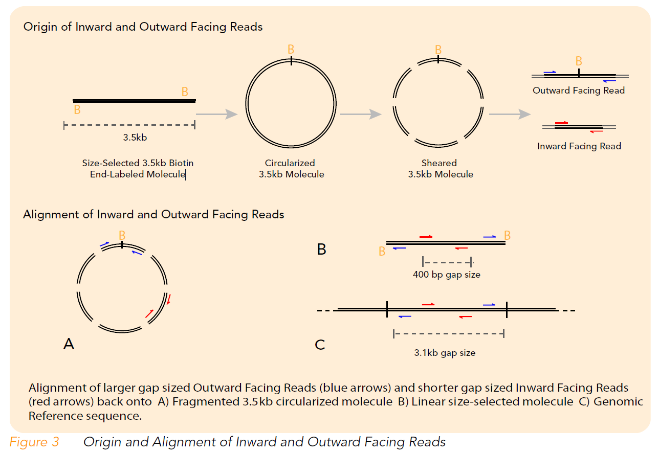

Slide 23
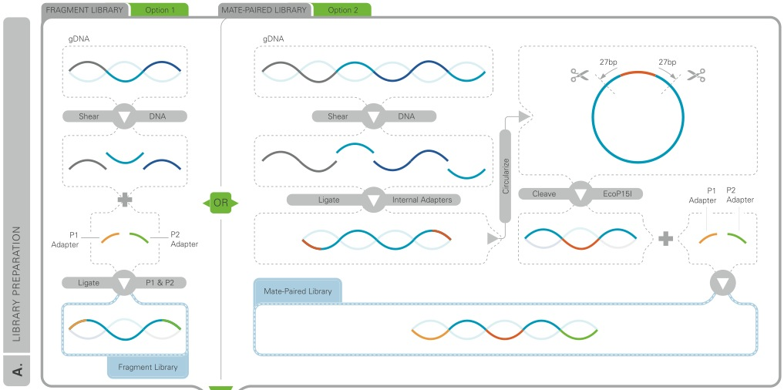
c. Applied Biosystems/Life technolgies SOLiD (Sequencing by Oligonucleotide Ligation and Detection).
In this ligation-based sequencing system, DNA ligase is used to identify the nucleotide present at a given position in a DNA sequence; each base is read twice, which increases accuracy, even with homopolymers.
1) prepare library of DNA fragments, which are attached to magnetic beads
2) each fragment attached to universal P1 adapter sequence (start sequence is identical for all fragments)
3) conduct emPCR
4) bond beads w/ PCR products to glass surface
5) hybridize primers to adapter sequences
6) series of fluorescently-labeled dibase probes compete for ligation to the primers
7) sequencing involves multiple steps involving 5 primers, each primer is1 base shorter incrementally
Step 1: SOLiD library prep: In the simplest library, two different adapters are ligated to sheared genomic DNA fragments (left). For more rigorous analysis, a “mate-pair” library can be generated by incorporating a circularization/cleavage step prior to adapter ligation (right).

Slide 24
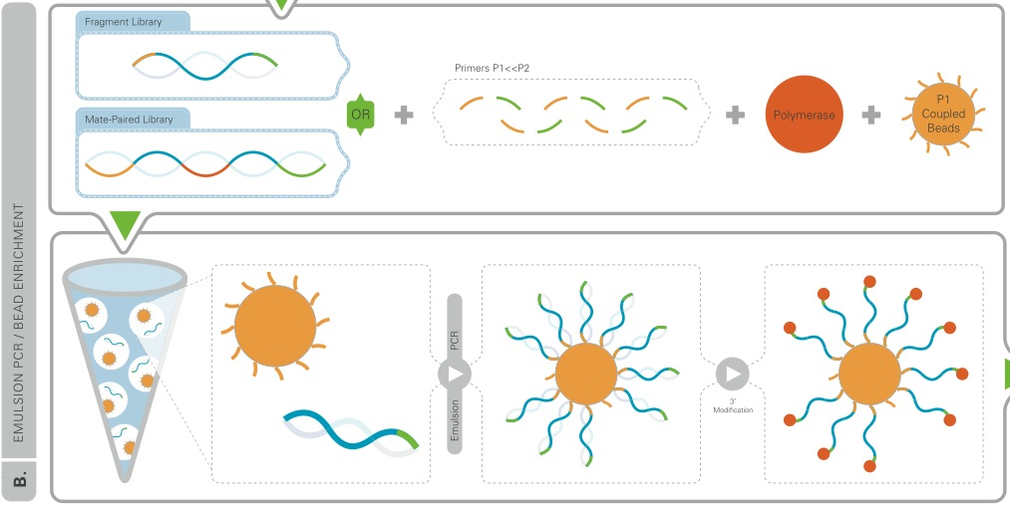
After ligating the adapters to the library, emulsion PCR is performed using the two primers (P1, P2) to generate “bead clones” which each contain a single nucleic acid species. Because beads are coated with the P1 primer, the P2 primer is added in excess.
After PCR, the 3’ ends (P2 ends) of amplified fragments are modified to facilitate their bonding to surface of flow cell.

Slide 25
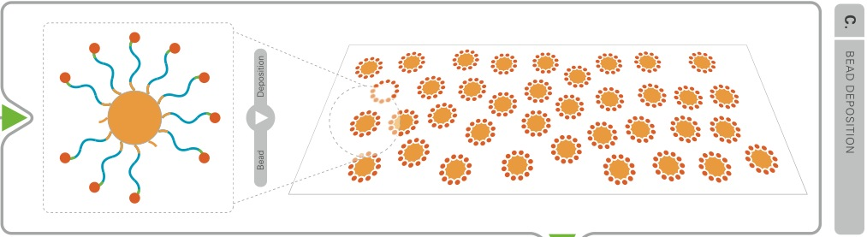
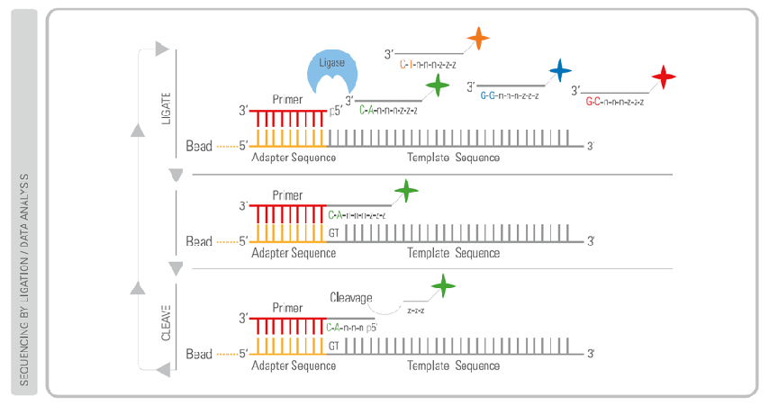
Beads with clonal DNA fragments are bonded to glass surface of flow cell
SOLiD sequencing uses different 8-base oligos, which compete for ligation to template

Slide 26
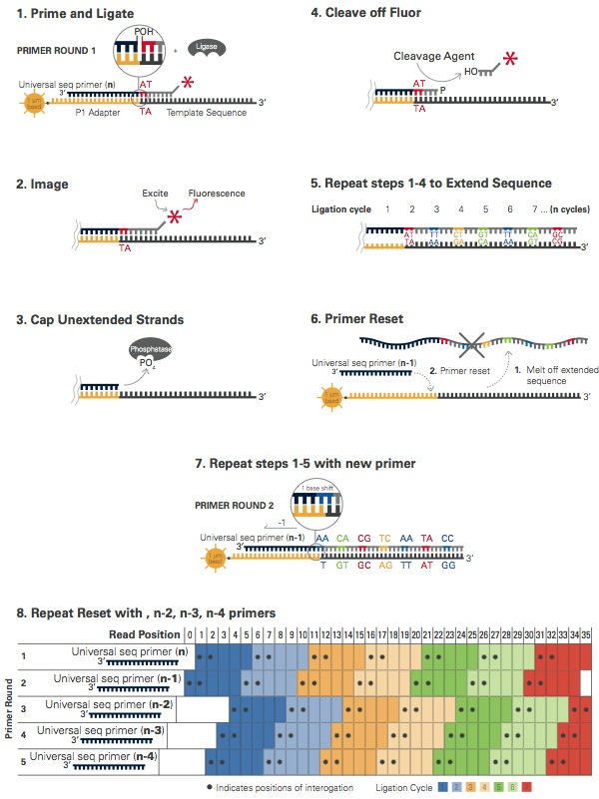
SOLiD sequencing

Slide 27
In SOLiD, base detection uses a mixture of labeled oligonucleotides, which queries the input strand with ligase.
Each oligo has degenerate positions at bases 3-5 (N’s), and one of 16 specific dinucleotides at positions 1-2 (numbered from the 3' end). Positions 6 through the 5’ are also degenerate (likely inosine [which pairs with A, C, U], but has not been confirmed by ABI), and hold one of four fluorescent dyes.
SOLiD sequencing involves:
Anneal a primer, then hybridize and ligate a mixture of fluorescent oligos (8-mers) whose 1st & 2nd 3' bases find a match to that of the template
Detect the specific fluor (imaging)
Cap unextended fragments with the same mixture of nonfluorescent probes; treat with phosphatase to prevent any unextended strands from contributing to “out of phase” ligation events
Remove fluor via two step chemical cleavage of the three 5' bases. This leaves behind a 5 base ligated probe, with a 5' phosphate
Repeat, this time querying the 6th & 7th bases
After 5-7 cycles of this, perform a “reset”, in which the initial primer and all ligated portions are melted from the template and discarded.
Next a new initial primer is used that is N-1 in length. Repeating the initial cycling (steps 1-5) now generates an overlapping data set (bases 1/2, 6/7, etc, see Fig 4, Step 8 above).
Thus, 5-7 ligation reactions followed by 5 primer reset cycles are repeated generating sequence data for ~35 contiguous bases, in which each base has been queried by two different oligonucleotides.
There are 16 possible dinucleotides (4²) but only 4 dyes, so data from a single color call does not indicate the base at a given position. So how are bases called?
There are 4 oligos for every dye, meaning there are four dinucleotides that are encoded by each dye.

Slide 28
SOLiD overview:
Each base is read twice along a shifting reading frame, as a component of a shifted dinucleotide. The two individual encodings are combined to encode the sequence by its “color space”.
Any given color-space sequence has four possible mappings into base-space.
To convert between color-space and base-space at least one base must be known from within the sequence where the color-space mapping was derived.
SOLiD sequencing is not subject to homopolymeric errors; however, the intrinsic error rate generally is higher than pyrosequencing.
The use of a reference genome can provide significant error-correction. This approach can distinguish read errors from single-nucleotide polymorphisms because a SNP would require both adjacent dinucleotide encodings to change with respect to the reference sequence, whereas a read error would be expected to produce only a single dinucleotide encoded error.

Slide 29
SOLiD:

Slide 30
SOLiD:
In this example the dinucleotides AC, CA, GT and TG all are encoded by the green dye.
Because each base is queried twice it is possible, using the two colors, to determine which bases were at which positions.

Slide 31
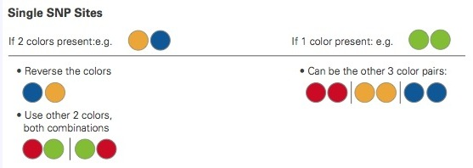
Color change “rules”:
When aligning to a reference and attempting to determine variants, all true variants will follow specific color change "rules" as shown above.
Refer to this document if you are interested in additional details on SOLiD:
http://www3.appliedbiosystems.com/cms/groups/mcb_marketing/documents/generaldocuments/cms_058265.pdf

Slide 32
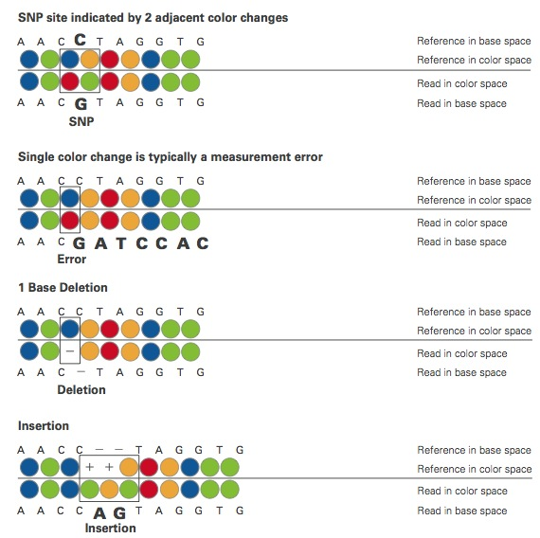
Detection of a true SNP (and not an error) is reflected by changes in two adjacent colorspace calls, not just one.

Slide 33
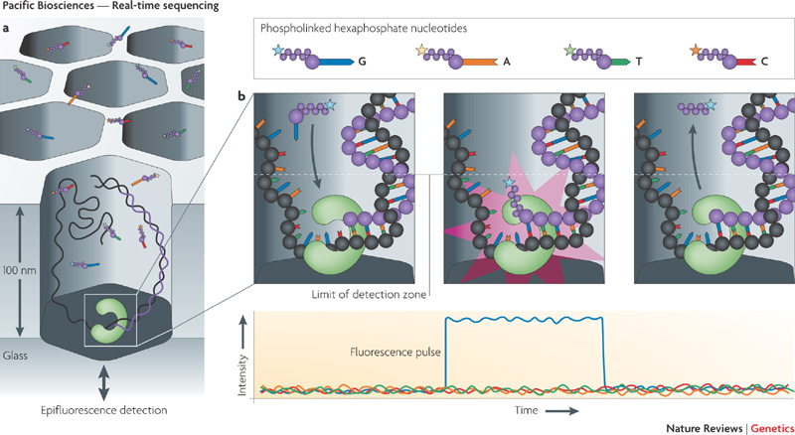
d. 3rd-generation sequencing (also sequence by synthesis):
Pacific Biosystems: single-molecule technique (real-time sequencing)
Pacific Biosciences' four-color real-time sequencing method. Each cavity contains a single DNA template immobilized
via the DNA polymerase, which is attached to the surface of the glass cell.

Slide 34
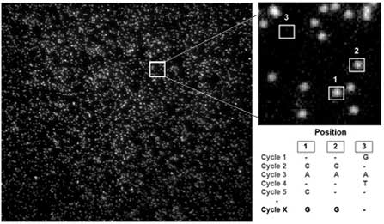
Helicos: How tSMS (true single-molecule sequencing) works:
Within two flow cells, billions of single molecules of sample DNA are captured on an application-specific proprietary surface.
These captured strands serve as templates for the sequencing-by-synthesis process:
Polymerase and one fluorescently labeled nucleotide (C, G, A or T) are added.
The polymerase catalyzes the sequence-specific incorporation of fluorescent nucleotides into nascent complementary strands
on all the templates.
After a wash step, which removes all free nucleotides, the incorporated nucleotides are imaged and their positions recorded.
The fluorescent group is removed in a highly efficient cleavage process, leaving behind the incorporated nucleotide.
The process continues through each of the other three bases.
Multiple four-base cycles result in complementary strands greater than 25 bases in length synthesized on billions of
templates—providing a greater than 25-base read from each of those individual templates.
An image taken by the HeliScope Single Molecule Sequencer. Inset shows a close-up view of individual single molecules.

Slide 35
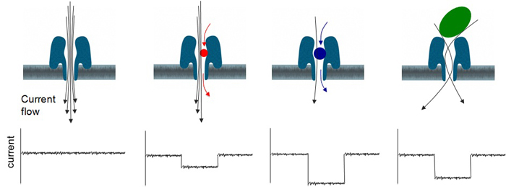
Oxford nanopore technology:
Oxford’s nanopore technology has a different sequencing approach currently in the developmental phase. It uses a scanning tunneling electron microscope (TEM) to measure alterations of conductivity across a nanopore while a single DNA molecule passes through. The amount of current that can pass through the nanopore at any given moment varies depending on the shape, size, and length of the nucleotide blocking the ion flow through the pore. The change in current through the nanopore as the DNA molecule passes through represents a direct reading of the DNA sequence. An exonuclease is used to cleave individual nucleotides from the DNA, and when coupled to an appropriate detection system these nucleotides could be identified in the correct order.
This diagram shows a protein nanopore set in an electrically resistant membrane bilayer. An ionic current is passed through the nanopore by setting a voltage across this membrane.
If an analyte passes through the pore or near its aperture, this event creates a characteristic disruption in current. By measuring that current, it is possible to identify the molecule in question. For example, this system can be used to distinguish between the four standard DNA bases G, A, T and C, and also modified bases. It can be used to identify target proteins, small molecules, or to gain rich molecular information, for example to distinguish the enantiomers of ibuprofen or molecular binding dynamics.

Slide 36
Developing technologies:
Electronic detection for single-molecule sequencing:
Reveo is developing a technology to stretch out DNA molecules on conductive surfaces for electronic base detection. A stretched and immobilized strand of DNA will be read through by multiple nano-knife edge probes. Each nano-knife edge probe specifically recognizes only one nucleotide for single-molecule sequencing. Intelligent Biosystems is also developing a platform using the electronic detection approach which will allow for high speed and high sensitivity single-molecule analysis with decreased background noise.
Electron microscopy for single-molecule sequencing:
Electron microscopy (EM) was the first proposed and attempted approach to sequence DNA molecules before the Sanger sequencing was established and this concept has recently been reevaluated with the emergence of new technologies. Since scanning tunneling microscopy (STM) can reach atomic resolution, STM for single-molecule sequencing is being explored. LightSpeed Genomics is developing a microparticle approach by capturing sequence data with optical detection technology and new sequencing chemistry from a large field of view to reduce the time consuming sample and detector rearrangement. Halcyon Molecular is developing a DNA sequencing technology by atom-by-atom identification and EM analysis. The key advantage of this technology is very long read lengths. ZS Genetics is also developing EM-based technologies for single-molecule DNA sequencing.

Slide 38
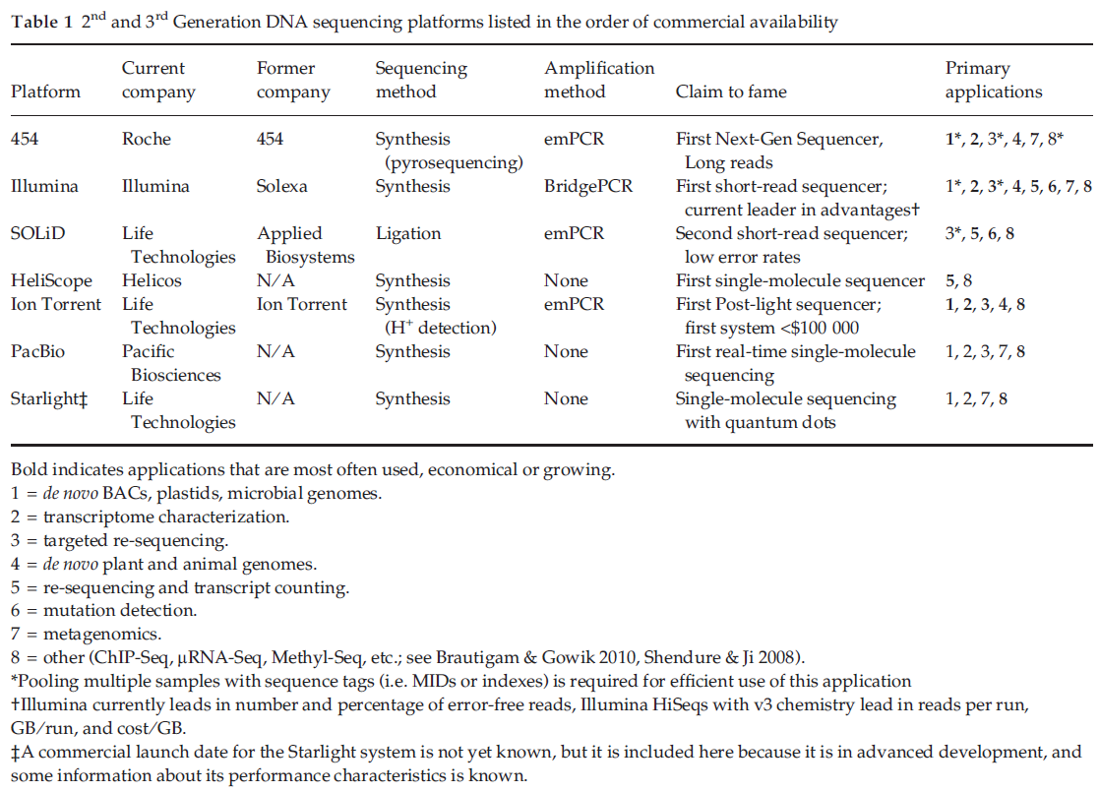

Slide 39
What type of information are we after - Full genomes or “targeted” regions?
“de novo” sequencing: does not require any knowledge of DNA structure (everything potentially gets sequenced)
“targeted” sequencing: specific, localized regions of a genome are selected for sequencing
genome: all genetic information of an organism, typically expressed as the number of DNA basepairs. –
Includes nDNA, mtDNA, cpDNA as well as coding and noncoding regions and transcribed and non-transcribed
regions (most inclusive).
transcriptome: the complete set of RNA molecules (transcripts) derived from a given sample of cells (can differ in
the same individual); includes mRNA, tRNA, miRNA (micro RNA), lncRNA (long non-coding RNA), etc.
The transcriptome can vary with external environmental conditions!!
RNA-seq =“whole transcriptome shotgun sequencing” = use NGS to sequence cDNA
exome: the complete exon content of an individual (no introns); protein-coding regions only
(The human genome consists of ~180,000 exons constituting about 1% of the total genome, (~30 megabases of DNA)
Exome sequencing = “targeted exome capture”
translatome: the set of all proteins translated from the mRNA (least inclusive)
The proteome is the full complement of proteins encoded by the genome, the secretome is the part of it secreted from the cell; the translatome describes the members of the proteome weighted by their abundance, and the functome describes all the functions carried out by these.
Sequencing these different subsets requires different library preparations that
select for the desired pool of templates.

Slide 40
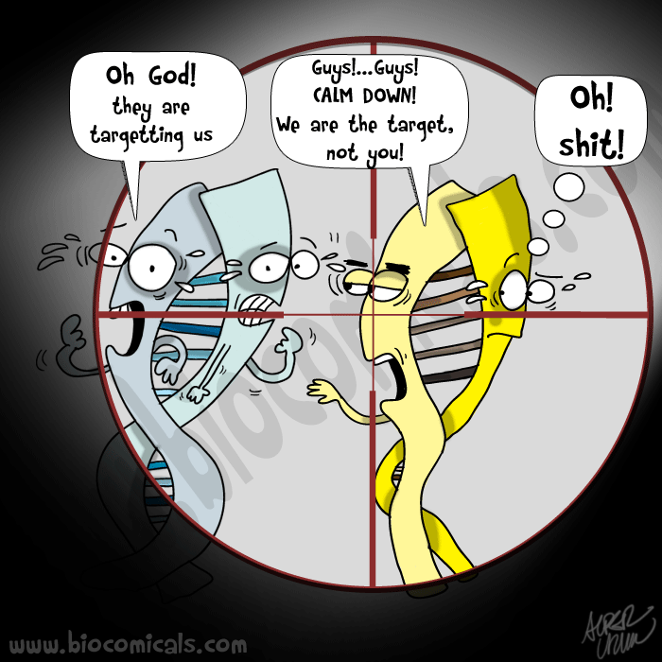
TARGETED RESEQUENCING:
Targeted resequencing isolates genomic regions of interest in a sample library, focusing on targets and mutations.
Targeted resequencing is a variation of re-sequencing where only a small subset of the genome is sequenced, such as the exome (common), a particular chromosome, a set of genes or a region of interest.
It is done generally to reduce costs, or where sequencing only particular regions (e.g., in clinical applications) is necessary.
By focusing all sequencing on a small region of the genome, it is possible to detect low levels of variation that might otherwise have been missed. Targeted resequencing is being used for genome-wide association studies (GWAS) instead of arrays because it better measures rare alleles.
Overview:
Targeted resequencing involves various methods of sample preparation that produce libraries representing the desired subset of the genome (often the exome in medical research). By targeting the exome of an individual, genetic variants can be identified that potentially could yield a disease phenotype. Additionally, by targeting the exomes of multiple individuals, rare variants can be found for further analysis of their functional consequences.
Exome sequencing: Typically uses a ‘solution-based capture’ or ‘microarray capture’ method.

Slide 41
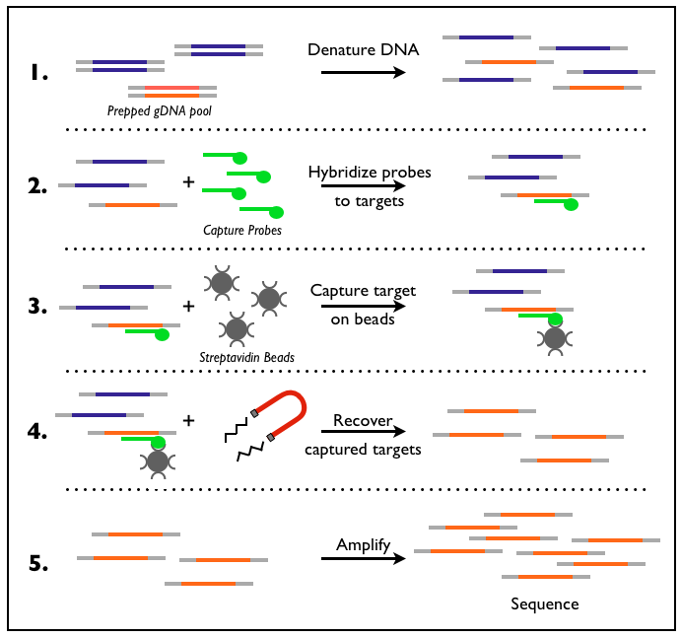
Solution-based capture:
Solution-based capture is highly scalable and generally cheaper than array-based capture when a large number of samples is involved.
After fragmenting the genome, the desired target fragments are captured by hybridizing the sample to baited probes, which can then be separated from the rest of the sample. Separation is achieved by connecting the probes to a bead substrate via an interaction (often magnetic or antigen-antibody complexing) with a probe-attached bead, followed by a wash step to remove unbound, non-targeted fragments. The resulting DNA can is then used to prepare a standard NGS library.
This method recovers nearly all sequences targeted by the probe set. Because both probes and targeted sequences are mobile in the solution, the probability of probe-target hybridization is high.
“baits”: DNA or RNA probes generated by biotinylated, array-synthesized oligonucleotides

Slide 42
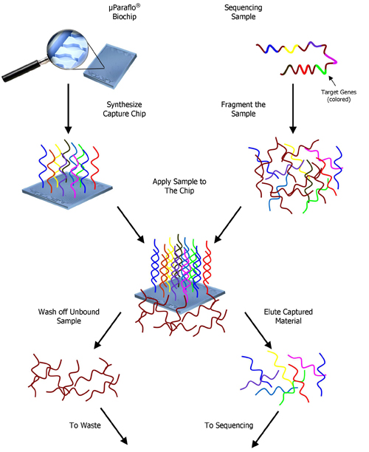
Microarray-based capture:
Array-based methods are effective when the target design is used across a small number of samples (up to 20 or so). Studies focusing on even smaller regions of the genome can also employ PCR-based approaches.
In array-based methods, probes fixed to a chip are hybridized to fragmented genomic DNA, which immobilizes fragments containing the complementary target sequences. Unbound fragments are removed and the targeted DNA sequences are eluted off and used for library preparation. The use of microarrays is ideal for recovering all of the targeted sequences, but it typically requires large amounts of input DNA and is less scalable than solution-based capture.

Slide 43
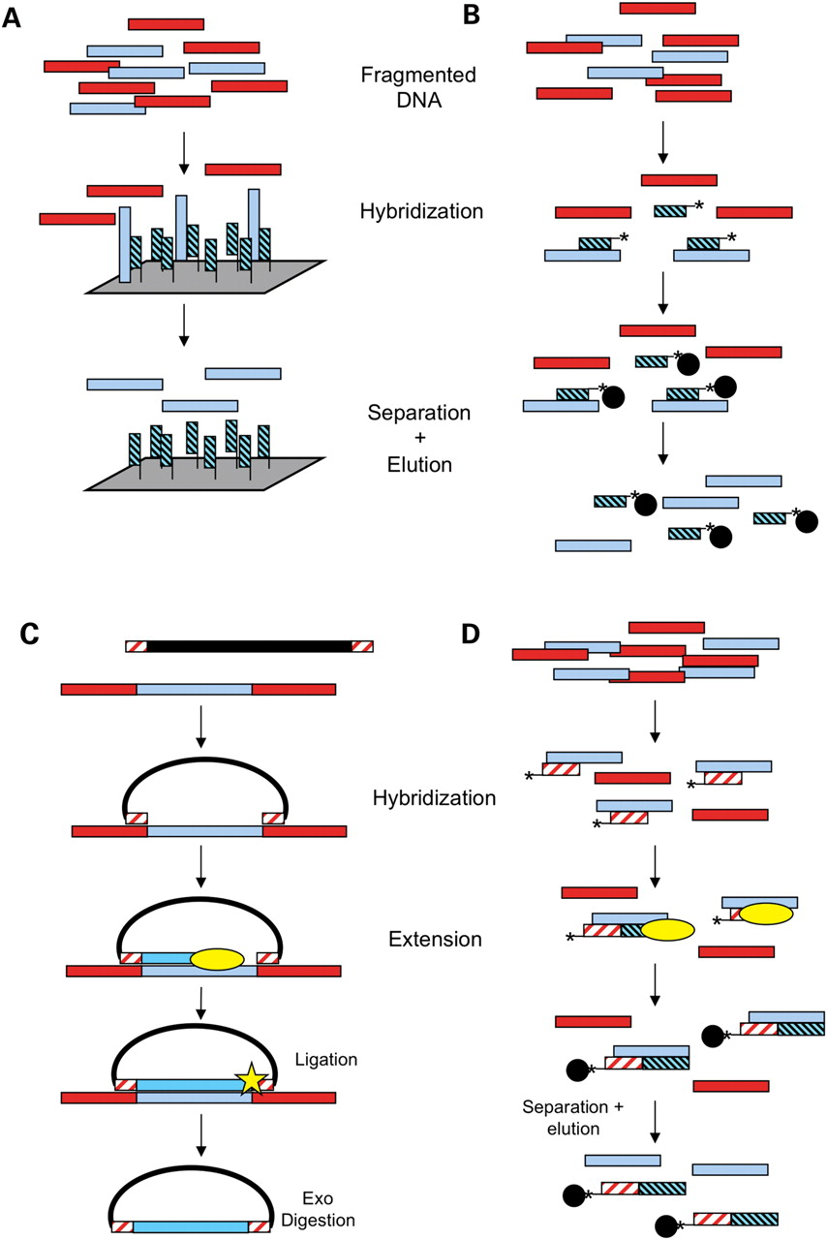
Illustration of different capture methods. Light blue bars represent desired genomic sequence, red bars represent unwanted sequence.
Solid-phase hybridization. Bait probes (light blue and black) complementary to the desired sequence are synthesized on a microarray. Fragmented genomic DNA is applied, and the desired fragments hybridize. The array is washed, and desired fragments are eluted.
Liquid-phase hybridization. Bait probes (light blue and black) complementary to the desired regions are synthesized, often using microarray technology. The probes are generally biotinylated (asterisk). The bait probes are mixed with fragmented genomic DNA, and the desired fragments hybridize to baits in solution. Streptavidin beads (black circles) are added to allow physical separation. The bead-bait complexes are washed, and desired DNA is eluted.
MIP (molecular inversion probes). Single-stranded probes composed of a universal linker backbone (black line) and arms complementary to the sequence flanking desired regions (red and white) are synthesized, often using microarray or microfluidics technology. The probes are added to genomic DNA and hybridize in an inverted manner. A polymerase (yellow oval) fills in the gap between the two arms. A ligase (yellow star) seals the nick, resulting in a closed single-strand circle. Genomic DNA is digested with exonucleases, and the captured DNA is amplified using sequences in the universal backbone.
PEC (primer extension capture). Biotinylated primers (red and white) are added to fragmented genomic DNA, where they hybridize to the desired sequence. A polymerase (yellow oval) extends the primer, creating a tighter interaction. Streptavidin beads (black circles) are added and are used to physically separate the desired DNA from the unwanted DNA. The desired DNA is then eluted.

Slide 44
amplicon sequencing: sequencing of an clonally amplified (usually via PCR) fragment
Template Preparation (e.g., 454): The DNA sample preparation procedure for Amplicon Sequencing consists of a simple PCR amplification reaction, but uses special “Fusion Primers”. The 3’-part of each primer is designed to anneal with a specific sequence on either side of the target of interest, on the initial (e.g. complex) DNA sample, delineating the margins of the amplicon that will be produced (which should be no longer than 500 bp). This requires detailed knowledge of the target sequence, in particular the sites targeted by the primers. The 5’-part of the primers exists in two types, “A” and “B”, to match other components of the sequencer system.
The Amplicon library preparation procedure incorporates emulsion-based clonal amplification (emPCR), allowing for single molecule sequencing without cloning the target sequences into bacteria. Two emPCR kits are available for Amplicon sequencing, one for sequencing a library from Primer A and the other for sequencing from Primer B.
5’
Primer A
Template-specific primer (L)
Template to be sequenced
Template-specific primer (R)
Primer B
5’
Schematic representation of an amplification product generated by the Amplicon library preparation procedure described above. The composite primers each comprise a 20-25 bp target-specific sequence region at their 3’-end; and a 19 bp region (Primer A or Primer B) that will be used in subsequent clonal amplification and sequencing reactions, at their 5’-end.

Slide 45
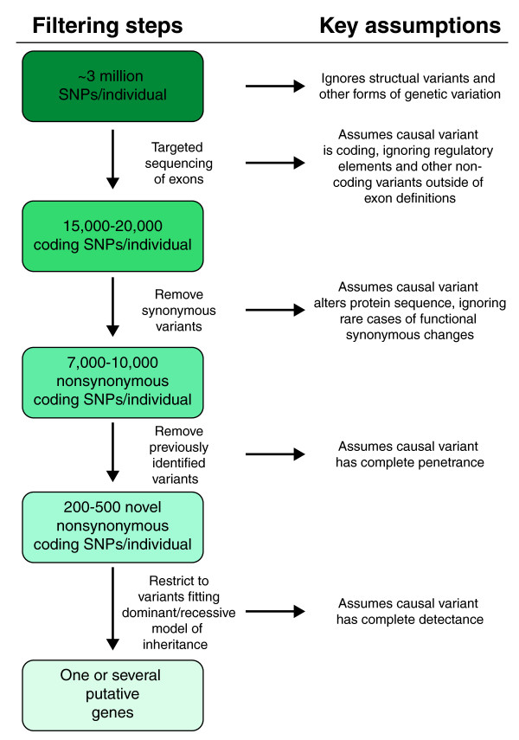

Slide 46
coverage: = total # bases sequenced/size of genome sequenced. Provides an estimate of how many times each base in the genome will be sequenced on average (1x, 2x, 3x, etc.).
NGS approaches require that every base in a sample be sequenced several times for two reasons:
1. You need multiple observations per base for reliable base calls.
2. Reads are distributed unevenly across an entire genome because they represent an independent, random sample. Many bases will be covered by fewer reads than the average coverage, while other bases will be covered by more reads than average.
Coverage is expressed by the coverage metric, which is the number of times a genome has been sequenced (i.e., the depth of sequencing). For applications where only a defined subset of an entire genome is sequenced (e.g, targeted resequencing or RNA sequencing), coverage means the amount of times you sequence that subset. For example, for targeted resequencing, coverage means the number of times the targeted subset of the genome is sequenced.
The Lander/Waterman equation is a method for computing coverage: C = LN / G
• C = coverage
• G = haploid genome length
• L = the read length
• N = the number of reads
NOTE: complete genomes include nuclear, mitochondrial, and (for plants) chloroplast genomes as well and should be taken into account when estimating coverage; however, their contribution to the overall genome size is proportionally negligible.
depth: = coverage (genome level) or number of supportive reads (nucleotide level)
How much coverage or depth you need depends on what you are doing, e.g., SNPs require a minimum of 4× coverage to be called by most programs.
Excess coverage is necessary in certain instances, e.g.:
... if certain journals or fields require a higher level of coverage for your particular application.
... when you are investigating events that are very rare. For example, detecting transcripts that are expressed at a very low level in RNA sequencing
... when certain genomes require more sequencing, e.g., hard to sequence regions may require more coverage, or polyploid genomes will require additional coverage.

Slide 47
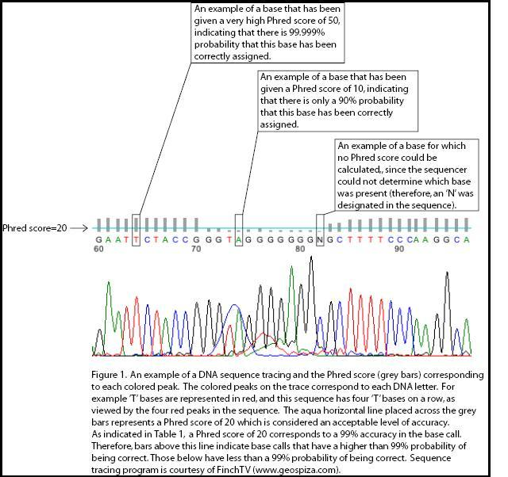
NGS error rates: the Quality Score (Q)
• Each base position in a sequence comes with a “quality score” (stored as FASQ file format).
• This measures the probability that a base is called incorrectly, by a “Phred”-like algorithm similar to that originally developed
for Sanger sequencing experiments. Phred is a computer algorithm designed for fluorescent base-calling.
• The quality score of a given base (Q) is defined by:Q = −10 log₁₀ P ... where P is the estimated probability of the base call
being wrong.
Phred Quality Score | Probability of Incorrect Base Call | Base Call Accuracy
10 | 1 in 10 | 90%
20 | 1 in 100 | 99%
30* | 1 in 1,000 | 99.9%
40 | 1 in 10,000 | 99.99%
50 | 1 in 100,000 | 99.999%
Quality scores and estimated base calling accuracy
*Q=30 is the desired NGS benchmark where nearly all calls will be correct. Standard Sanger sequencing is about 99.4% accurate, or ~Q=20.

Slide 48
Restriction site Associated DNA (RAD) sequencing using NGS is a method for producing genomic data at the population level in non-model organisms. It can be used for SNP and SSR discovery and genotyping, genotype-phenotype association mapping, scaffolding genome assemblies through linkage mapping, QTL analysis, hybridization and gene flow analysis, phylogeography, and population genetics. In this approach, the complete genomic DNA of each sample is digested by restriction enzymes, (which reduces the complexity of the whole genome) and then tagged with an ID molecular barcode specific for each individual/cohort/population. RAD tags are the DNA sequences that immediately flank each instance of a particular restriction enzyme site throughout a genome.
The method involves cutting a genome with at least one restriction enzyme and sequencing the ends of the resulting fragments using an Illumina Sequencing System. The fragments from one individual are ligated to a modified Illumina adapter containing a unique identifying sequence (Molecular IDentifier, or MID). The fragments from many individuals can therefore be pooled together and sequenced on a single lane. The resulting reads can be separated bioinformatically by identifying the MID at the start of each read. By sequencing a family or other population of interest in this way, and comparing the tags to the phenotypes of the individuals, many biologically relevant SNPs and genetic loci can be identified in a single experiment. Also, because the reads can be easily processed bioinformatically, it is possible to resort individuals into different pools and reanalyse the data for different phenotypes.

Slide 49
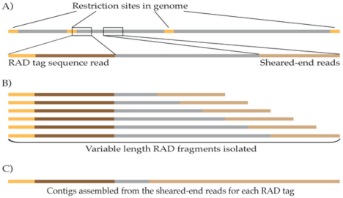
RAD sequencing/tags (uses Illumina systems)
RAD paired-end contigs are assembled from the randomly sheared fragment ends that sample the region around a restriction site. Sequences sharing a restriction site sequence are assembled into a contig that forgoes many of the problems of whole-genome assembly.

Slide 50
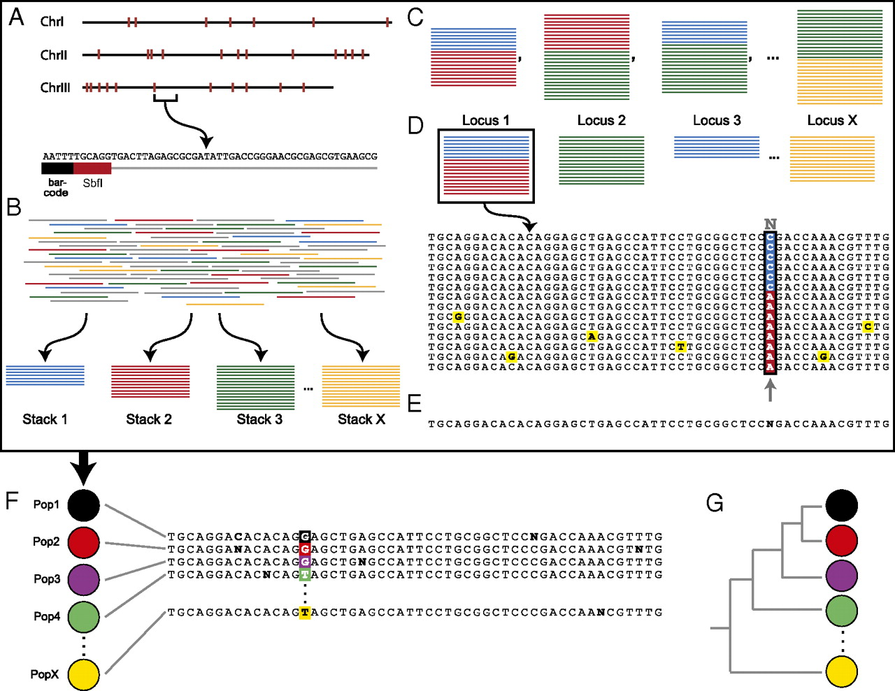
In silico RAD tag genotyping within (A–E), and SNP discovery between (F and G), populations. (A) W. smithii has three nuclear chromosomes, each of which contains multiple SbfI cut sites (red marks). The genomic DNA is digested, barcoded with a population-specific sequence, and amplified, resulting in multiple sequence reads from each of the RAD tag sites in the genome. Each sequence consists of a population-specific 5-bp barcode (black), the enzyme-recognition sequence (red), and the downstream sequence. (B) The de novo RAD tag pipeline compares all the sequenced reads and builds stacks of exactly matching tags. (C) Pairwise comparisons are made between all stacks, i.e., blue vs. red, red vs. green, blue vs. green, and so on. (D) Loci were defined as a set of stacks such that for each stack, there is another stack in the locus that is at most one nucleotide divergent. Each locus is then examined one nucleotide position at a time. If the nucleotide at that position is at a significantly high frequency within the population, it is considered to be the consensus nucleotide; if not, it is replaced with an N, resulting in (E) the consensus sequence for that RAD tag site within the population. (F) This process is repeated for each of the populations. (G) The resulting RAD tag consensus sequences are then used for phylogenetic analysis (from Emerson et al. 2010).

Slide 51
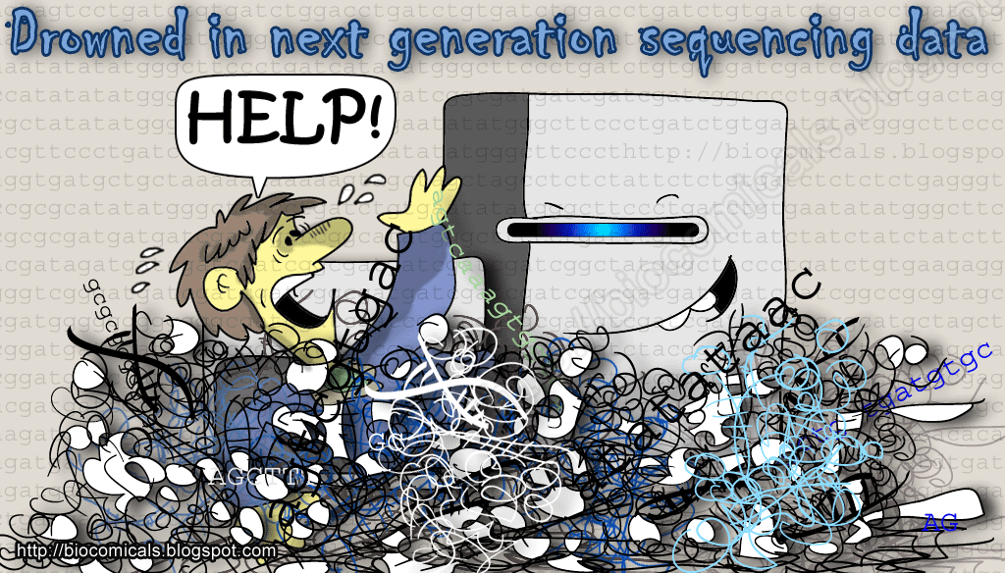
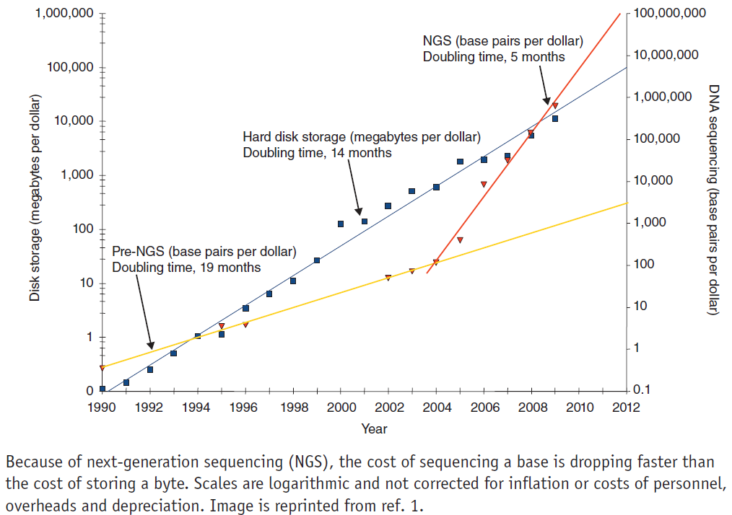
BIOINFORMATICS: The REAL challenge?

Slide 52
Baker, M. 2010. Next-generation sequencing: adjusting to data overload. Nature Methods 7: 495-499.
See:
Bioinformatics software:
--- http://bioinformatics.ca/links_directory/
DNA sequence alignment programs:
--- http://en.wikipedia.org/wiki/List_of_sequence_alignment_software
Genomics and cloud computing:
Definition (National Institute of Standards):
Mell, P. & T. Grance. 2011. The NIST Definition of Cloud Computing NIST Special Publication 800-145. Computer Security
Division, Information Technology Laboratory, National Institute of Standards and Technology, Gaithersburg, MD 20899-8930.
--- http://gigaom.com/cloud/as-genomics-pushes-big-data-limits-cloud-could-save-the-day/
--- http://www.genome.gov/27538886

